Slide 1
D2 Driving Standards
Notes:
Explain how long the talk will take and cover what will be discussed.
You will need to know what your company’s policy is regarding driving standards and incorporate any materials used
Before you start
Make sure you have a copy of:
The FORS standard
Ensure you have the accompanying notes of the presentation
Ensure you have slide packs to hand to drivers at the end of the talk

Slide 2

Fleet Operator Recognition Scheme (FORS)
FORS is important to our company because it helps us:
Demonstrate the quality of our operation
Improve our road safety record
To win / maintain work
Remain legally compliant
Become more efficient
Reduce our environmental impacts
Requirement:
Fleet operators shall require that anyone driving on business shall drive within the Highway Code and company policy at all times and pay particular regard to vulnerable road users.
Notes:
- Explain what FORS is: ‘FORS aims to raise the level of quality within fleet operations, and demonstrate which operators are achieving the standard’
Explain the importance of FORS to the company and to the drivers
Not all the images or examples used in the talk may be relevant to how you work. Where this is the case, use examples from your own workforce.

Slide 3
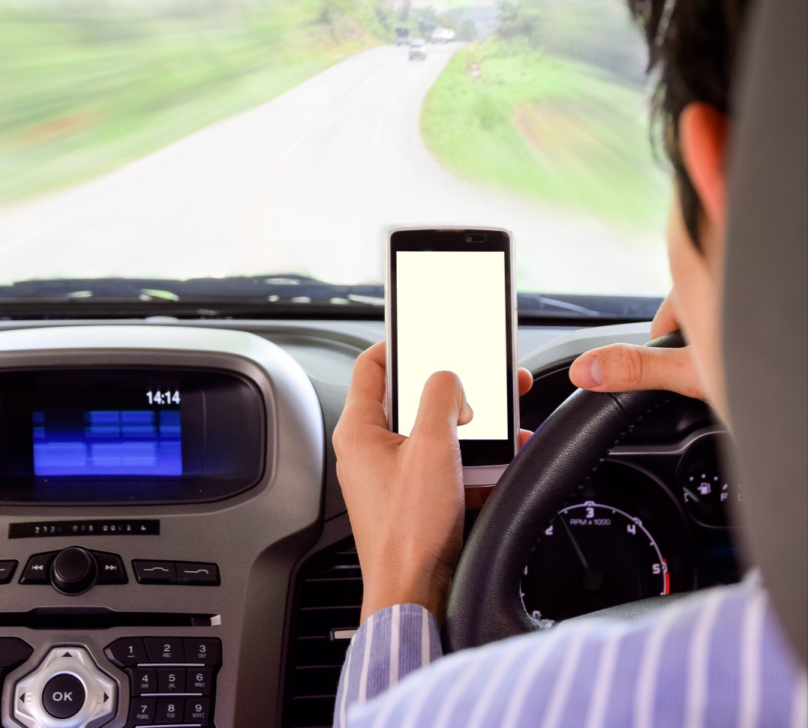
Aim of toolbox talk
The aim of this toolbox talk is to communicate company policy of ensuring that all drivers (including sub-contracted and agency drivers):
Drive within the Highway Code
Follow company policy at all times
Pay particular attention to vulnerable road users

Slide 4
What can you do?
Always obey the speed limit
Always use your seat belt
Never use your mobile phone or other in-vehicle technology whilst driving
Do not eat, drink or smoke whilst driving
Watch out for vulnerable road users
Take sufficient breaks
Never drive under the influence of drugs or alcohol
Drive smoothly, avoid sudden harsh braking and rapid acceleration
Notes:
How to maintain your driving standards:
• Always obey the speed limit - remember they are NOT ‘targets’ but absolute limits (as stated in Rule 124 – Highway Code - Speed limits)
• Never use a handheld mobile phone or other in vehicle technology whilst driving – even when in stationary traffic. If you need to make or take a call, pull over into a safe place and switch the engine off
• Drive safely – anticipate and adjust to road and traffic conditions
• Drive smoothly, avoiding sudden harsh braking and rapid acceleration to avoid destabilising any load
• Do not eat, drink, smoke, listen to loud music or argue with passengers whilst driving (as stated in Rule 148 of the Highway Code – Safe driving and riding needs concentration)
• Always wear a seat belt whenever in the vehicle
• Make sure that you concentrate on the road as driving ‘in a fog’ or ‘on autopilot’ increases the risk of collisions
• Allow for the effect that your load may have on the vehicles handling characteristics and make sure its maximum authorised mass is not exceeded
• Assess whether your ability to drive safely and legally is affected or likely to be affected by:
− Medicines
− Illegal or controlled substances
− Alcohol
− Tiredness
− A short or long-term physical condition
− Your emotional state
• Assess whether drivers hours regulations permit you to drive and take sufficient breaks
• Continue to make effective observations, including checks of blind spots, while manoeuvring
Drivers should ensure the upkeep of general driving standards and the safety of all road users. This can mean:
• Drivers stay safe on the roads
• Speed limits are upheld
• The safety of vulnerable road users is improved
• The correct actions are taken following breakdowns and collisions
• Safety equipment (where applicable) is used correctly
• Avoiding the use of mobile phones and other in-vehicle technology unless safe to do so
• Drivers don’t drive when tired or under the influence of drink and drugs

Slide 5
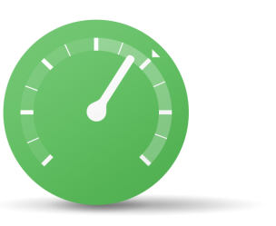

Keeping to the speed limit
Speeding is a one of the main factors in fatal road accidents
Plan your journey accordingly, always assume some delay due to traffic
In 2014, 282 people were killed by someone exceeding the speed limit. 126 people died when someone was travelling too fast for the conditions
Know your speed limits!
Remember! - If you cause an accident you will have to live with the emotional consequences of deaths or injuries caused to others
Rule 124 of the Highway Code states: You must not exceed the maximum speed limit for the road and for your vehicle
Notes:
Test your drivers on their knowledge of the speed limit. Try varying the vehicle type and whether a trailer is being towed or not

Slide 6
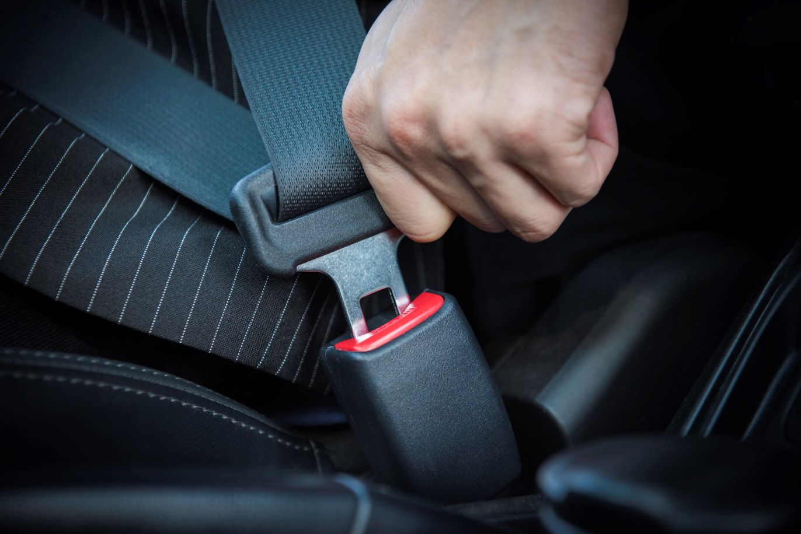
Using your seat belt
Always use your seat belt - In a crash you are twice as likely to die if you don’t
Put your seat belt on before starting your journey
Encourage your passengers to do so
Using your seat belt can save your life
Rule 99 of the Highway Code states: Drivers must wear a seat belt in cars, vans and other goods vehicles if one is fitted

Slide 7
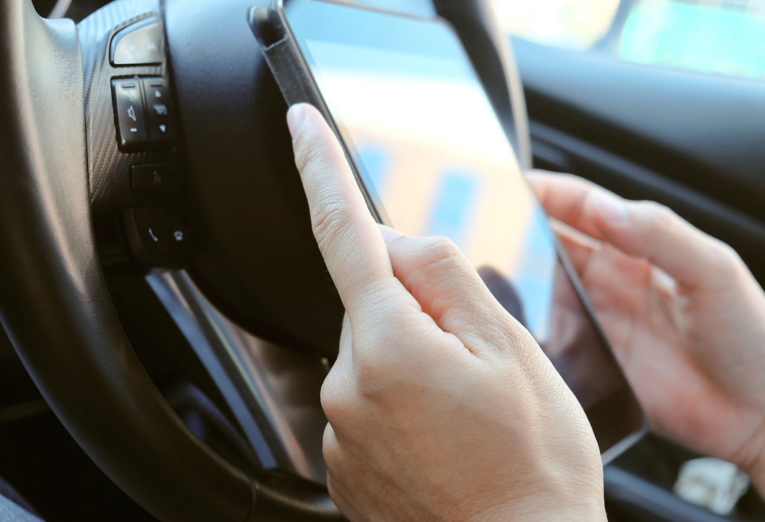
Mobile phone / in-vehicle technology usage whilst driving
It is illegal to use your mobile while driving
If go to court you could be disqualified from driving and get a maximum fine of £1,000
Set your sat nav before starting your journey
Rule 149 of the Highway Code states: You must not use a hand-held mobile phone, or similar device
Notes:
It is illegal to use your mobile while driving. If caught you will get 3 penalty points on your licence and a fine of £100
If go to court you could be disqualified from driving and get a maximum fine of £1,000. Drivers of buses or goods vehicles could get a maximum fine of £2,500

Slide 8


Smoking, drinking or eating in company vehicle
Smoking is against the law in company vehicles
All vehicles should display non-smoking signs in each compartment of the vehicle in which people can sit
Although it is not illegal to eat whilst driving, police could prosecute you for careless driving if they consider you are not in proper control of the vehicle
Notes:
It is against the law to smoke in company vehicles. The law doesn’t apply to e-cigarettes, employers can decide if they can be used on their premises.
A driver can smoke in a company car that only they use if their employer agrees.
Although it is not illegal to eat whilst driving police could prosecute you for careless driving if they consider you are not in proper control of the vehicle.
Rule 148 of the Highway Code ‘Safe driving and riding needs concentration’ states:
Avoid distractions when driving or riding such as:
loud music (this may mask other sounds)
trying to read maps
starting or adjusting any music or radio
arguing with your passengers or other road users
eating and drinking
smoking

Slide 9






Taking extra care with vulnerable road users (VRU)
Motorcyclists and cyclists not always visible when coming out of junctions, overtaking you or filtering through traffic
Horses may behave unpredictably
Children are small, playful, curious, poor at judging speed, and can run fast
Teenagers get distracted, use headphones and may challenge each other to ‘dares’
Older or disabled pedestrians walk slowly
Blind or deaf pedestrians can’t see or hear you
Notes:
Explain how important it is to take extra care to avoid collisions with VRU because a pedestrian, cyclist, motorcyclist or horse rider will always come off worse.
Pedestrians: Drivers should be ready for the unexpected. They should not park on pavements, and always stop at zebra crossings if someone is waiting to cross. More than 60 child pedestrians are killed or seriously injured every week and nearly half of all pedestrians killed are aged over 60. Give them time and room to cross, the vehicle`s speed can make the difference between life and death.
Motorcyclists: can be difficult to see, especially at junctions and they are often moving quicker than expected. Drivers need to give them time and room and be especially careful when turning left and at roundabouts / junctions.
Horse riders: Drivers must drive very slowly when overtaking them, keep the engine noise as low as possible and avoid sounding the horn.

Slide 10
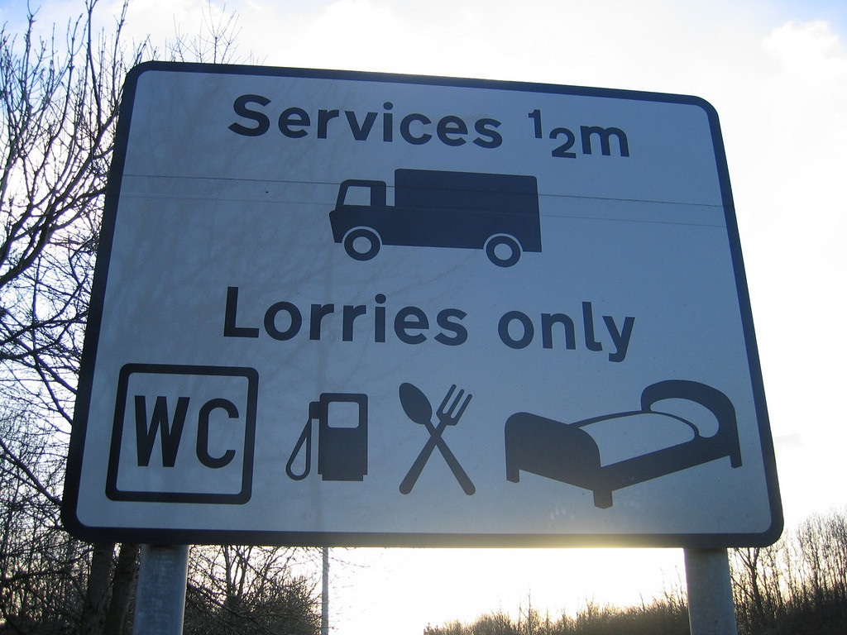
Taking sufficient breaks
It is your responsibility to ensure you are fit to drive. Make sure you have had sufficient breaks before each shift
Do not start a long trip if you are already tired
About 40% of sleep-related accidents involve commercial vehicles
Remember, the only real cure for sleepiness is proper sleep. A caffeine drink or a nap is a short-term solution that will only allow you to keep driving for a short time

Slide 11
Driving under the influence of drugs or alcohol
In 2013, 14% of all road fatalities were due to drink driving. On average 3,000 people are killed or seriously injured each year in drink drive collisions
By drinking and driving, you risk your life, those of your passengers and others on the road
There are strict penalties if you are convicted of drink driving, including:
A minimum 12 month driving ban
A criminal record
A hefty fine
Up to 6 months in prison
An endorsement on your licence for 11 years
Rule 96 of the Highway Code states: Drivers must not drive under the influence of alcohol and drugs
Notes:
Driving under the influence of alcohol or drugs is illegal. Any breach of this rule could result in instant dismissal from employment as well as prosecution / imprisonment. (Please check your company policy regarding drink driving and drug usage.)
The way alcohol affects you depends on your weight, age, sex and metabolism (the rate your body uses energy), the type and amount of alcohol you’re drinking, what you have eaten recently, your stress levels at the time.
So if you’re driving, it’s better to have none for the road.
It`s possible to be over the limit from alcohol consumed the previous night. The desirable level of alcohol to have in a driver`s system is zero.
The Institute of Advanced Motorists calculate that a drink drive conviction could cost between £20,000 - £50,000 as a result of fines, solicitors fees, increased insurance premiums and loss of job.

Slide 12
Driving smoothly and avoiding harsh braking
Try and look 15 seconds ahead – not just at the vehicle in front
Avoiding sudden harsh braking and rapid acceleration to avoid destabilising any load
Anticipate and adjust to road and traffic conditions
Keep your concentration and stay alert to identify hazards
Stick to the speed limit
Keep your distance
Smooth acceleration uses less fuel than putting your foot down hard so go easy on the throttle.
CONSIDERATION – ANTICIPATION - CONCENTRATION
Notes:
Note that they
Will need to leave more distance in adverse weather conditions
Driving smoothly:
Helps to save lives
Reduces driver stress
Leads to fewer incidents of road rage or aggressive driving
Saves money - driving smoothly and steadily is highly fuel efficient and gets you there just as quickly.

Slide 13
Benefits
Driving within the Highway Code and company policy and paying particular regard to vulnerable road users will help to ensure you:
Are a safer driver and contribute to improving road safety for all road users
Operate within the framework of the law
Reduce your chances of receiving penalty points / fines or even being banned from driving
Are a more professional driver making you more employable
Do not damage your reputation as well as the company’s
Notes:
Driving within the Highway Code and company policy and paying particular regard to vulnerable road users will help to ensure you:
Are a safer driver and contribute to improving road safety for all road users
Operate within the framework of the law
Reduce your chances of receiving penalty points / fines or even being banned from driving
Are a more professional driver making you more employable
Do not damage your reputation as well as the company’s
In addition you will help the company to:
Reduce our insurance premiums due to you having fewer collisions
Increase vehicle productivity and reduce the downtime of our vehicles that might have been involved in collisions
Improve our reputation as a safe operator
Win new work

Slide 14
Understanding the toolbox talk
What are the reasons for ensuring the upkeep of general driving standards and the safety of all road users?
Why is it important to drive within the Highway Code and company policy?
What is the maximum speed limit in a built-up area for a vehicle over 3.5 tonnes?
When is it suitable to use a mobile phone (without a hands-free kit) in a vehicle?
Is it ever appropriate to be sitting in a vehicle with the seatbelt not fastened?
Give an example of a safe, systematic approach when manoeuvring a vehicle that maintains safety of yourself and other road users?
Notes:
1. What are the reasons for ensuring the upkeep of general driving standards and the safety of all road users?
2. Why is it important to drive within the Highway Code and company policy?
3. What is the maximum speed limit in a built-up area for a vehicle over 3.5 tonnes?
4. When is it suitable to use a mobile phone (without a hands-free kit) in a vehicle?
5. Is it ever appropriate to be sitting in a vehicle with the seatbelt not fastened?
6. Give an example of a safe, systematic approach when manoeuvring a vehicle that maintains safety of yourself and other road users?

Slide 15

Summary – remember, it is all about:
Obeying the speed limit
Using your seat belt
Not using your mobile phone when driving or other in-vehicle technology whilst driving
Not smoking, drinking or eating behind the wheel
Taking extra care with vulnerable road users
Taking sufficient breaks
Not driving under the influence of drugs or alcohol
Driving smoothly and avoiding harsh braking and rapid acceleration
Notes:
It is very important that you know the basic speed limits of your vehicle and the maximum speed limits you can do on different roads. Remember that you do not need to be travelling at the maximum speed limit. Consider the traffic, road and weather conditions to avoid incidents from occurring
It is illegal to handle a mobile phone whilst driving and if caught it will result in points on your licence and a fine.
Wearing a seatbelt is a legal requirement. Always make sure that you are wearing yours as there is no valid reason for not wearing one.
Finally always look out for vulnerable road users, remember sometimes unless you are looking out for them you will not see them!
Thank you for your time – and now I would like your feedback.

Slide 16
Any questions ?
Notes:
Ask drivers if they have any questions. If you have difficulty with any questions, seek further advice from your manager.
Encourage discussion at the end of the presentation so drivers can interact with one another.
Follow up any points that are raised at the presentation, eg by holding a further, perhaps more specific session on issues in relation to working at height and the prevention of fall from vehicles which may have been raised in the presentation
Issue out a toolbox talk register and remind drivers to complete this, as their attendance record will be important.
Thank them for their time and ask for feedback.

