Slide 1
D5 Health and safety
Notes:
Introduce yourself and the talk
Let the audience know that the talk will take approximately twenty minutes
Before you start
Make sure you have a copy of:
The FORS standard
Accompanying notes of the presentation
Slide packs to hand to drivers at the end of the talk

Slide 2
Fleet Operator Recognition Scheme (FORS)
FORS is important to our company because it helps us:
Demonstrate the quality of our operation
Improve our road safety record
To win / maintain work
Remain legally compliant
Become more efficient
Reduce our environmental impacts
Requirement:
Fleet operators shall ensure that road driving risks and workplace transport safety are controlled via a working health and safety policy and that vehicle-specific driver health and safety advice is given to drivers
Notes:
- Explain what FORS is: ‘FORS aims to raise the level of quality within fleet operations, and demonstrate which operators are achieving the standard’
You should explain to driver what you want to achieve by giving this talk
Explain the importance of FORS to the company and to the drivers
Not all the images or examples used in the talk may be relevant to how you work. Where this is the case, use examples from your own workforce.

Slide 3
Aim of toolbox talk
The aim of this toolbox talk is to communicate this companies health and safety policy to all drivers (including sub-contracted and agency drivers) and ensure you are fully aware of the vehicle-specific driver health and safety advice that this company provides
Notes:
Thinkstock image: 536309727
The aim of this toolbox talk is to communicate this companies health and safety policy to all drivers (including sub-contracted and agency drivers) and ensure you are fully aware of the vehicle-specific driver health and safety advice that this company provides

Slide 4
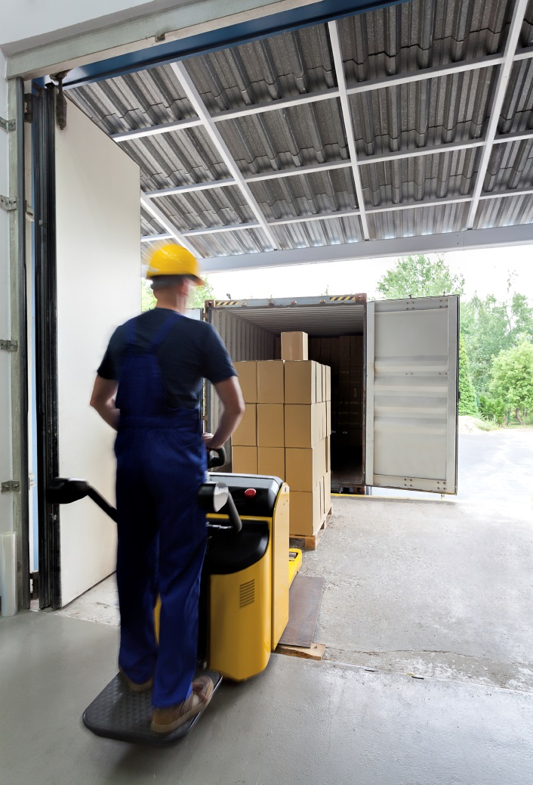
How this toolbox talk will help you
Provide you with essential information on work related road safety
Get you to think more about the causes of road accidents and how to prevent them
Guide you through the most important points of transport safety related law
Help you to understand how to report incidents and near misses
Notes:
Thinkstock image:164923442
This toolbox talk will provide you with essential information on work related road safety, It will get you to think more about the causes of road accidents and how to prevent them. It will also guide you through some of the most important points of transport safety related law.
The talk will end with some confirmatory questions, so listen up!

Slide 5
Why health and safety?
Every year, there are over 5000 accidents involving transport in the workplace. About 50 of these result in people being killed
More than a quarter of all road traffic incidents may involve somebody who is driving as part of their work at the time
Some of the common accidents involving workplace transport include:
Being struck by a vehicle
Falls from vehicles
Overturning vehicles
Falling loads
Being crushed by a vehicle
Notes:
Every year, there are over 5000 accidents involving transport in the workplace. About 50 of these result in people being killed.
More than a quarter of all road traffic incidents may involve somebody who is driving as part of their work at the time
Health and safety forms the basis of every aspect of transport operations’ from loading vehicles and moving goods to manoeuvring vehicles and site layouts. You need to take preventive measures to reduce the likelihood of accidents and ensure everyone around you takes responsibility for their own safety.
Some of the common accidents involving workplace transport include:
Being struck by a vehicle
Falls from vehicles
Overturning vehicles
Falling loads
Being crushed by a vehicle
As a company we are committed to protecting the health and safety of all employees. We want to make sure that YOU have a clear understanding of your responsibilities and have the correct training to ensure risk is reduced.
It is essential therefore that you understand how to report incidents, near misses and potential future issues and are aware of the risks which may impact upon your occupational health including driving position, moving loads by hand or machinery and vibration.
Remember a hazard is something in your business that can cause harm. A risk is the chance, however large or small, that a hazard could cause harm.

Slide 6
Who is responsible?
You must take reasonable care for your own health and safety and that of others who may be affected by what you do or do not do
You should not interfere with or misuse anything provided for your health, safety and welfare.
You should also be aware of the correct procedures to follow in the event of a breakdown or if you are involved in an incident.
Notes:
Thinkstock image: 161872028
You must take reasonable care for your own health and safety and that of others who may be affected by what you do or do not do, and co‐operate with your manager on the health and safety requirements and rules etc.
You should not interfere with or misuse anything provided for your health, safety and welfare.
You should also be aware of the correct procedures to follow in the event of a breakdown or if you are involved in an incident.

Slide 7
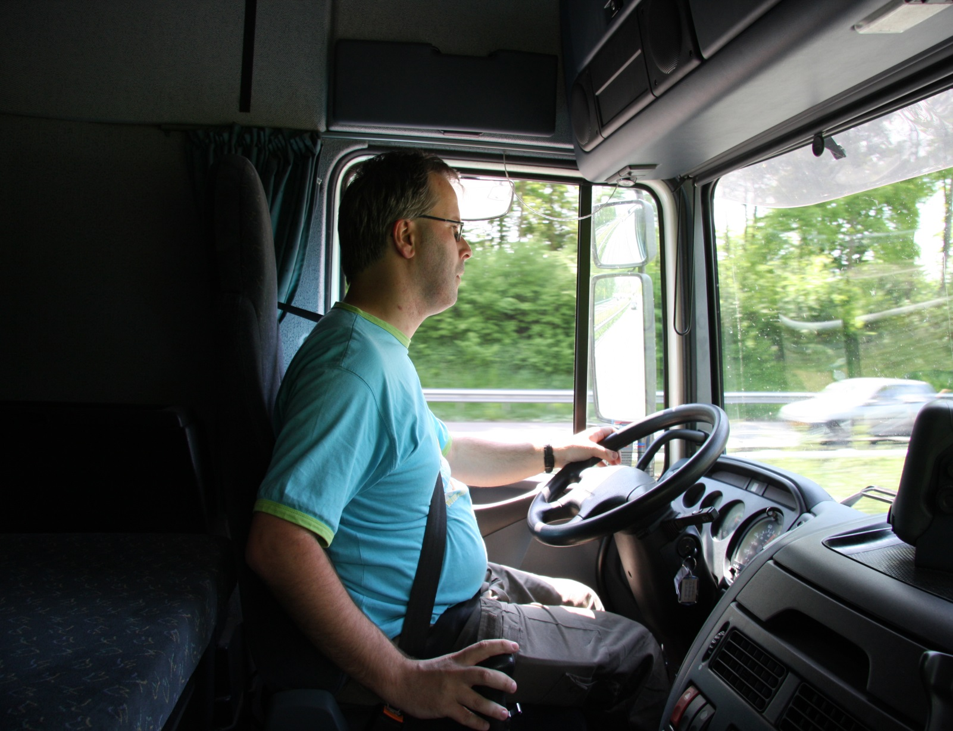
Safe driver
Familiarise yourself with the company health and safety policy
Make sure you’ve done your induction training
Get yourself trained properly e.g. Driver CPC (Safe Urban Driving, Staying legal), FORS eLearning etc
Learn how to carry out your routine safety checks, such as those on lights, tyres and report any faults
Don’t use in-vehicle technology whilst driving
Highlight any health concerns that might affect your ability to drive
Notes:
Thinkstock image:517416991
You can help us improve health and safety in the workplace by asking yourself the following questions:
Safe driver
Are you familiar with the health and safety policy?
Have you had your induction training?
Do you feel you have had enough training to do your job properly e.g. Driver CPC (Safe Urban Driving, Staying legal), FORS eLearning etc?
Do you know how to carry out your routine safety checks, such as those on lights, tyres etc and report any faults?
Are you aware that you must not use mobile phones while driving?
Are you aware of the height of your vehicle?
Have you had your eyesight tested in the last six months?
Have you got any health concerns that you think might need reporting?
Do you require refresher training?

Slide 8
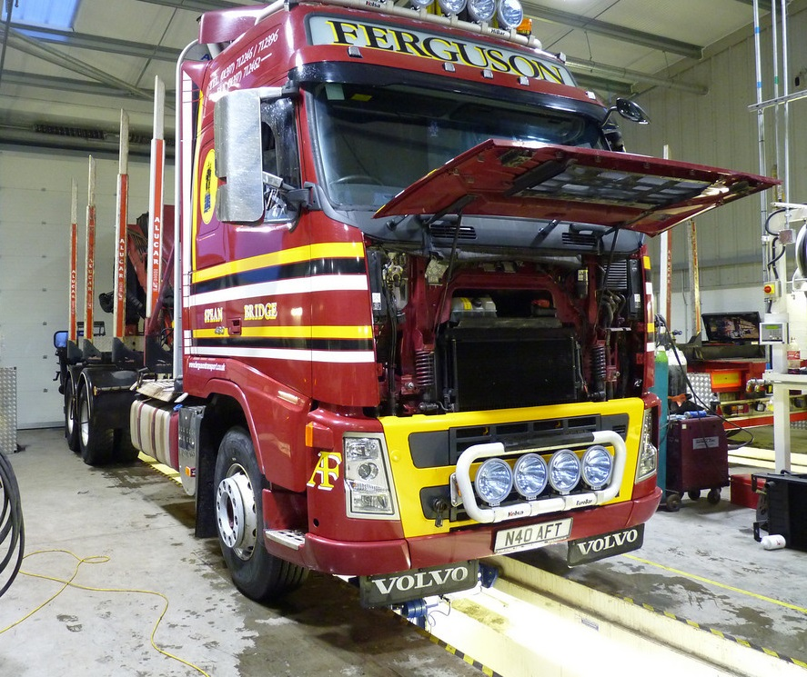
Safe Vehicle
If your vehicle is fitted with reversing alarms, camera systems and proximity sensors
Are you happy that your seatbelts / head restraints are fitted and working properly?
Are you confident your vehicle is not overloaded before you start/continue your journey?
Do you know how to carry out your daily walkaround check?
Are you familiar with how to report defects?
Notes:
Thinkstock image: 517416777
Safe vehicle
If your vehicle is fitted with reversing alarms, camera systems and proximity sensors – do you know how to operate them correctly?
Are you happy that your seatbelts / head restraints are fitted and working properly?
Are you confident your vehicle is not overloaded before you start/continue your journey?
Do you know how to secure your load properly and have you got enough straps to do so?
Do you know how to carry out your daily walkaround check?
Are you familiar with how to report defects?
Have you had guidance on good posture and do you know how to adjust your seat correctly?

Slide 9
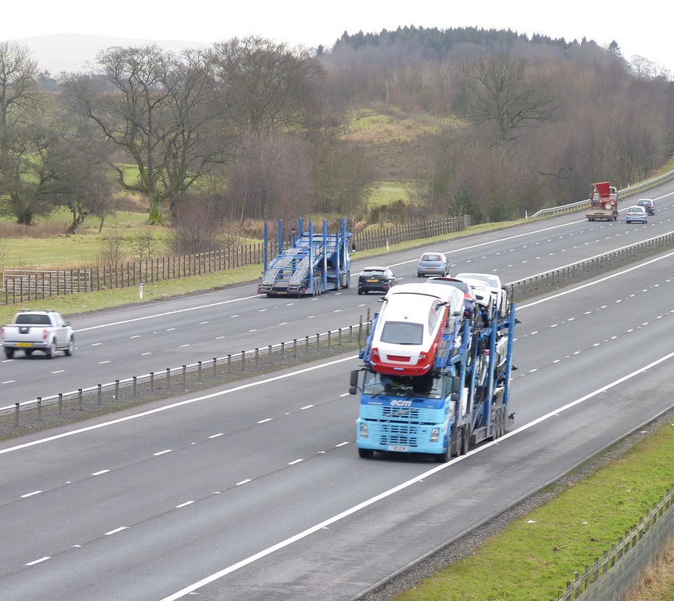
Safe Journey
Do you feel you could use safer routes which are more appropriate for the type of vehicle you are driving?
Do you feel like you are being given enough time to safely deliver loads and have rest breaks?
Is your vehicle properly equipped to deal with poor weather conditions?
Do you feel pressured to complete journeys where weather conditions are difficult and do you know who to contact if you need to cancel a journey?
Notes:
Thinkstock image: 515085668
Safe Journey
Do you feel you could use safer routes which are more appropriate for the type of vehicle you are driving? – If so have you informed your supervisor of this?
Do you know what procedure to follow if you start to feel tired?
Do you feel like you are being given enough time to safely deliver loads and have rest breaks?
Are your individual circumstances being considered before being asked to do a long shift?
Are you aware of the dangers of driving home after a long day?
Is your vehicle properly equipped to deal with poor weather conditions?
Do you feel pressured to complete journeys where weather conditions are difficult and do you know who to contact if you need to cancel a journey?

Slide 10
Risk assessments (what should you do?)
There are five steps to risk assessment that you need to be aware of:
Step 1 – Identify the hazards
Step 2 – Decide who might be harmed and how
Step 3 – Evaluate the risks and decide on precautions
Step 4 – Record your findings and implement them
Step 5 – Review your risk assessment and update if necessary
Remember - a hazard is something in your business that can cause harm. A risk is the chance, however large or small, that a hazard could cause harm
Notes:
This slide goes thorough aspects of risk assessment. You may wish to hand out the HSE ‘five steps’ leaflet to give to drivers for further reading
All employers must make ongoing assessments of any risk they, or their activities, may create to other workers and anyone else who may be affected by their activities. There are five steps to risk assessment that you need to be aware of:
Step 1 – Identify the hazards
Step 2 – Decide who might be harmed and how
Step 3 – Evaluate the risks and decide on precautions
Step 4 – Record your findings and implement them
Step 5 – Review your risk assessment and update if necessary
Things that you can do to help include:
Look for hazards that may result in harm in the workplace and whilst driving on public roads especially in urban areas. If you notice something wrong tell your supervisor
Are able to manage risk responsibly and protect people around you from any harm. (for example in the event of a breakdown you must make sure you are safe first and check on the safety of other parties involved)
Always report any near misses and incidents to your supervisor so that they have a record for future use (you should report any incidents, near misses or collisions within 24 hours)
Undertake the necessary training to improve your knowledge and expertise in managing risk at work

Slide 11
Benefits
Effective management of work related health and safety helps reduce risk and it:
Ensures that you know how to work safely
Develops a positive health and safety culture
Meets the legal duty to protect the health and safety of everyone in the workplace including yourself
Lessens the likelihood of financial loss to the company
Reduces the risk of work-related ill health
Lowers company driving costs through better driving standards
Cuts the risk of losing the goodwill of customers
Ensures fewer injuries to you (the driver)
Notes:
Effective management of work related health and safety helps reduce risk and it:
Ensures that you know how to work safely and without risks to your own personal health and those around you
Develops a positive health and safety culture
Meets the legal duty to protect the health and safety of everyone in the workplace including yourself
Lessens the likelihood of financial loss (through prosecution and compensation or loss of business through reputational damage) to the company
Reduces the risk of work-related ill health
Lowers company driving costs through better driving standards
Cuts the risk of losing the goodwill of customers
Ensures fewer injuries to you (the driver)
Reduces stress and improves morale

Slide 12
Understanding the toolbox talk
What are the most common accidents involving workplace transport?
What is the correct procedure for reporting incidents and near misses?
What actions should you take to ensure your safety following the breakdown of your vehicle?
What things do you need to check on your daily walkaround check?
What things can you do to help assess risks in the workplace and whilst driving?
Notes:
1. What are the most common accidents involving workplace transport?
2. What is the correct procedure for reporting incidents and near misses?
3. What actions should you take to ensure your safety following the breakdown of your vehicle?
4. What things do you need to check on your daily walkaround check?
5. What are the procedures for reporting vehicle defects?
6. What questions do you need to ask yourself to ensure you are a safer driver?
7. What things can you do to help assess risks in the workplace and whilst driving?
8. What is a near miss incident?

Slide 13
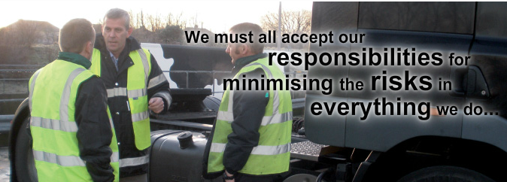
Health and safety summary
We need to make sure that risk is minimised while working.
It is vital for you to understand the importance of having a safe vehicle which is fit for its intended purpose/use.
You should also make sure that your journey is correctly routed taking into account of any road restrictions
Finally you should always be looking out for vulnerable road users to avoid any incidents/near misses from occurring.
Notes:
To sum up we need to make sure that risk is minimised while working. It is vital for you to understand the importance of having a safe vehicle which is fit for its intended purpose/use. You should also make sure that your journey is routed taking into account of any road restrictions such as bridges, road closures, public roads, schools and restrictions in place as well as your driving hours .
Finally you should always be looking out for vulnerable road users to avoid any incidents/near misses from occurring.
Thank you for your time – and now I would like your feedback.

Slide 14
Any questions ?
Notes:
Ask drivers if they have any questions. If you have difficulty with any questions, seek further advice from your manager.
Encourage discussion at the end of the presentation so drivers can interact with one another.
Follow up any points that are raised at the presentation, eg by holding a further, perhaps more specific session on issues in relation to working at height and the prevention of fall from vehicles which may have been raised in the presentation
Issue out a toolbox talk register and remind drivers to complete this, as their attendance record will be important.
Thank them for their time and ask for feedback.

