Slide 1
V3 Fuel and tyre usage
Notes:
Explain how long the talk will take and cover what will be discussed.
You will need to know what your company’s policy is regarding driving standards and incorporate any materials used
Before you start
Make sure you have a copy of:
The FORS standards and refer to (D2 – Page 33)
Ensure you have the accompanying notes of the presentation
Ensure you have slide packs to hand to drivers at the end of the talk

Slide 2
Fleet Operator Recognition Scheme (FORS)
FORS is important to our company because it helps us:
Demonstrate the quality of our operation
Improve our road safety record
To win / maintain work
Remain legally compliant
Become more efficient
Reduce our environmental impacts
Requirement:
Fleet operators shall record, monitor, and manage fuel and tyre usage.
Notes:
- Explain what FORS is: ‘FORS aims to raise the level of quality within fleet operations, and demonstrate which operators are achieving the standard’
Explain the importance of FORS to the company and to the drivers
Not all the images or examples used in the talk may be relevant to how you work. Where this is the case, use examples from your own workforce.

Slide 3
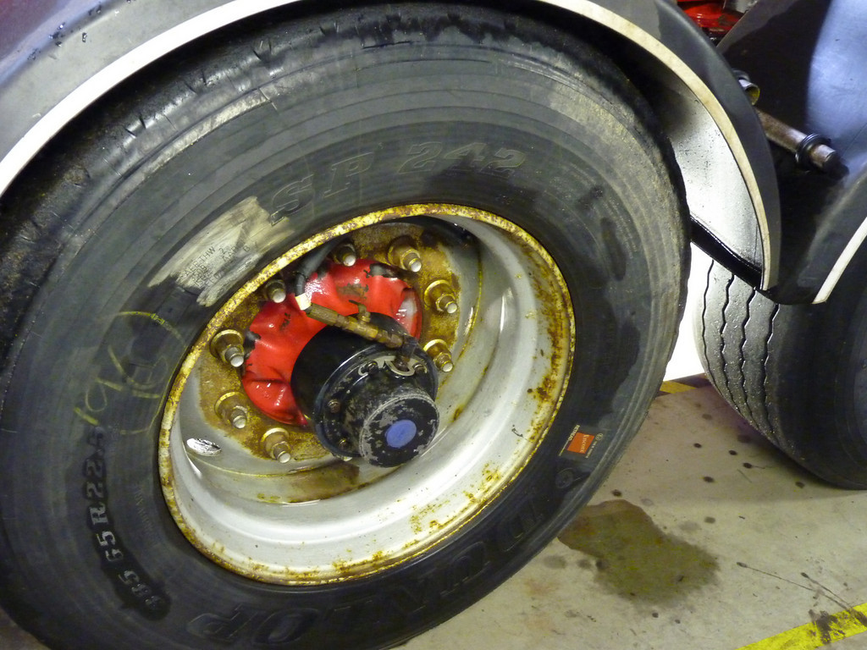
Aim of toolbox talk
The aim of this toolbox talk is to communicate to drivers the importance of minimising fuel use and tyre usage.
You will learn about the different methods to reduce fuel use and tyre usage, including:
Anti-idling
Driver training
Fuel efficient driving techniques
Changing the vehicles used and operating best practices
£700M WORTH OF FUEL IS WASTED EVERY YEAR ON ANTI IDLING
2 MINUTES SPENT IDLING IS EQUAL TO 1 MILE OF DRIVING
Notes:
The aim of this toolbox talk is to communicate to drivers (including sub-contracted and agency drivers), the importance of minimising fuel use and tyre usage. You will learn about the different methods to reduce fuel use and tyre usage, including anti-idling, driver training, fuel efficient driving techniques, changing the vehicles used and operating best practices. In addition you should make sure that you are following company policies and programmes to record your fuel and tyre usage.

Slide 4
How this toolbox talk will help you
This toolbox talk will go through the different measures which can help you save fuel and manage your tyre usage better.
By following some or all of these measures you can improve the efficiency of your company’s operations as well as become more fuel efficient.
This will help you to become a safer driver and also enable you to do your bit for the environment.
Saving
Fuel
Reduce emissions
Operational Efficiency
Notes:
This toolbox talk will go through the different measures which can help you save fuel and manage your tyre usage better. By following some or all of these measures you can improve the efficiency of your company’s operations as well as become more fuel efficient. This will help you to become a safer driver and also enable you to do your bit for the environment. The talk will end with some confirmatory questions, so listen up!

Slide 5
Importance of fuel and tyre usage
Our company goal is to ensure fuel and tyre usage is recorded, monitored and managed.
Road transport makes up about 22 per cent of the UK's CO2 emissions. HGVs account for around 20 per cent of this overall transport sector emission
Fuel represents 35% of a transport operators running costs
Driver and Vehicle Standards Agency (DVSA) officers and the police are able to issue fixed penalties at the roadside for vehicles which are not roadworthy.
Notes:
Our company goal is to ensure fuel and tyre usage is recorded, monitored and managed.
Road transport makes up about 22 per cent of the UK's CO2 emissions. HGVs account for around 20 per cent of this overall transport sector emission: Source: National Atmospheric Emissions Inventory 2008.
Fuel represents 35% of a transport operators running costs
Driver and Vehicle Standards Agency (DVSA) officers and the police are able to issue fixed penalties at the roadside for vehicles which are not roadworthy. The charges vary depending on the type and frequency of the offence. Tyre tread depth features highly among the major criteria for vehicle roadworthiness

Slide 6
Why is this talk being given?
Apart from the obvious reasons of safety, drivers face stiff penalties for worn, bald or defective tyres and could even lose their licence.
Each bald or defective tyre carries a fine of up to £2,500 and three penalty points so if all aren't up to standard you could be looking at 12 points and an automatic ban.
Penalty points remain on the driving record for 4 years from the date of the offence
Check your tyre thread depths regularly. Fuel efficiency is important for the company and it shows you are acting as a professional driver..
As a driver you need to understand the importance of planning your journey as this will aid in saving fuel and tyre usage
Notes:
Apart from the obvious reasons of safety, drivers face stiff penalties for worn, bald or defective tyres and could even lose their licence. Each bald or defective tyre carries a fine of up to £2,500 and three penalty points so if all aren't up to standard you could be looking at 12 points and an automatic ban.
Penalty points remain on the driving record for 4 years from the date of the offence
Check your tyre thread depths regularly. The current tread depth legislation requires that truck tyres must have a minimum of 1mm of tread in a continuous band throughout the central three-quarters of the tread width and over the whole circumference of the tyre. The same regulation applies to regrooved tyres.
Fuel efficiency is important for the company and it shows you are acting as a professional driver. By being more fuel efficient you have the potential to reduce fuel usage by up to 20% thus saving money for the company.
As a driver you need to understand the importance of planning your journey as this will aid in saving fuel and tyre usage

Slide 7
How you can reduce your fuel usage
Record your mileage and fuel use for every journey you do
Minimise engine-idling
Don’t drive aggressively / drive at a safe speed limit
Think about the route you are taking to site – Is this the most efficient?
Reduce the number of gear changes and keep the vehicle moving where possible
Ensure loads and empty tipper bodies are correctly sheeted
Use the momentum of the vehicle on undulating roads to climb and descend hills
Use the exhaust brake instead of the footbrake
Avoid over-revving the engine
Know your average MPG for the vehicle you drive
Notes:
Full information on bullet points above, use what is relevant to your workplace:
Record your mileage and fuel use for every journey you do. This will help to pinpoint areas for improvement.
Minimise engine-idling – Today's vehicles are designed to warm up fast. Avoid idling when you can; idling is 0 miles per gallon. If your vehicle is likely to be stationary for more than two minutes switch the engine off
Don’t drive aggressively / Drive at a safe speed limit. Avoid aggressive driving and aggressive starts. All vehicles lose fuel economy at speeds above 55 m.p.h. A 22% reduction in fuel consumption can be achieved simply by reducing your speed from 56 to 50 MPH
Road type and traffic conditions play a part in the amount of fuel used on a journey. If you have to change gear, brake or accelerate more often, this will increase fuel usage. Think about the route you are taking to site (see O1 – Routing and scheduling). Is this likely to be the most efficient?
Try to plan ahead and use your visibility advantage provided by the high seating position in a truck to reduce the number of gear changes. Keeping a vehicle moving, even at walking pace, requires considerably less fuel use than moving a vehicle from a standstill.
Ensure loads and empty tipper bodies are correctly sheeted as this will reduce aerodynamic drag and save fuel. Tests show that by correctly sheeting an empty tipper body at 56mph you could see improvements of over 8%
Use the momentum of the vehicle on undulating roads to climb and descend hills. On modern, electronically controlled vehicles, when the foot is taken off the accelerator, fuel stops entering the combustion chamber and so the vehicle uses no fuel.
If you have cruise control, use it when its safe and appropriate to do so as this will maximise fuel economy.
Use the exhaust brake instead of the footbrake as this will contribute to smoother decreases in speed, increase the lifespan of brake linings and save fuel.
Avoid over-revving the engine – Lower revs give higher levels of fuel economy. Try and keep the engine revs within the green band.
Make sure the air deflectors are correctly adjusted for the type of trailer or load you are pulling
Park up in a way that will avoid early-morning manoeuvring with a cold engine - this wastes fuel
Know your average MPG for the vehicle you drive

Slide 8
How you can reduce your fuel usage
Make sure your tyres are correctly inflated before setting off
Don’t over-inflate your tyres
Make sure the tyre valves are free from dirt and caps are fitted to each wheel
Look out for any bulges, lumps or cuts to the tread and sidewalls and also remove any stones and other embedded objects
If the front tyres show signs of excessive or uneven wear get the steering alignment corrected
Where regrooved tyres are concerned, check that there are no exposed cords.
Notes:
The recommended tyre pressure should be stated on the vehicle. Make sure your tyres are correctly inflated before you set off on your journey. Correctly inflated tyres offer less resistance on the road, improve fuel economy, give greater stability and reduce the risk of accidents. A fall in tyre pressure of 10lb psi is likely to result in a 1% fall in fuel economy
Don’t over-inflate your tyres as this can reduce the vehicles handling and cause high wear in the centre of the tread.
Make sure the tyre valves are free from dirt and caps are fitted to each wheel
Look out for any bulges, lumps or cuts to the tread and sidewalls and also remove any stones and other embedded objects. You might want to think about covering these things in your daily walkaround check (Also see V2 toolbox talk)
If the front tyres show signs of excessive or uneven wear get the steering alignment corrected
Where regrooved tyres are concerned, check that there are no exposed cords. If there are advise your fleet manager immediately as the tyre is unsafe for use

Slide 9
Benefits
Adopting best practice in fuel efficient driving and improved tyre usage leads to:
Reduced fuel spend
Improved road safety
Increased productivity and vehicle utilisation
Reduced vehicle operating costs
Reduces the likelihood of receiving fines and penalty points for driving unroadworthy vehicles
Increased confidence in vehicle control and driving performance
Notes:
Thinkstock image: 473989528
Adopting best practice in fuel efficient driving and improved tyre usage leads to:
• Reduced fuel spend - A rise in profits could improve your job security. Your contribution counts!
• Improved road safety
• Increased productivity and vehicle utilisation
• Reduced vehicle operating costs
• Reduces the likelihood of receiving fines and penalty points for driving unroadworthy vehicles
• Increased confidence in vehicle control and driving performance

Slide 10
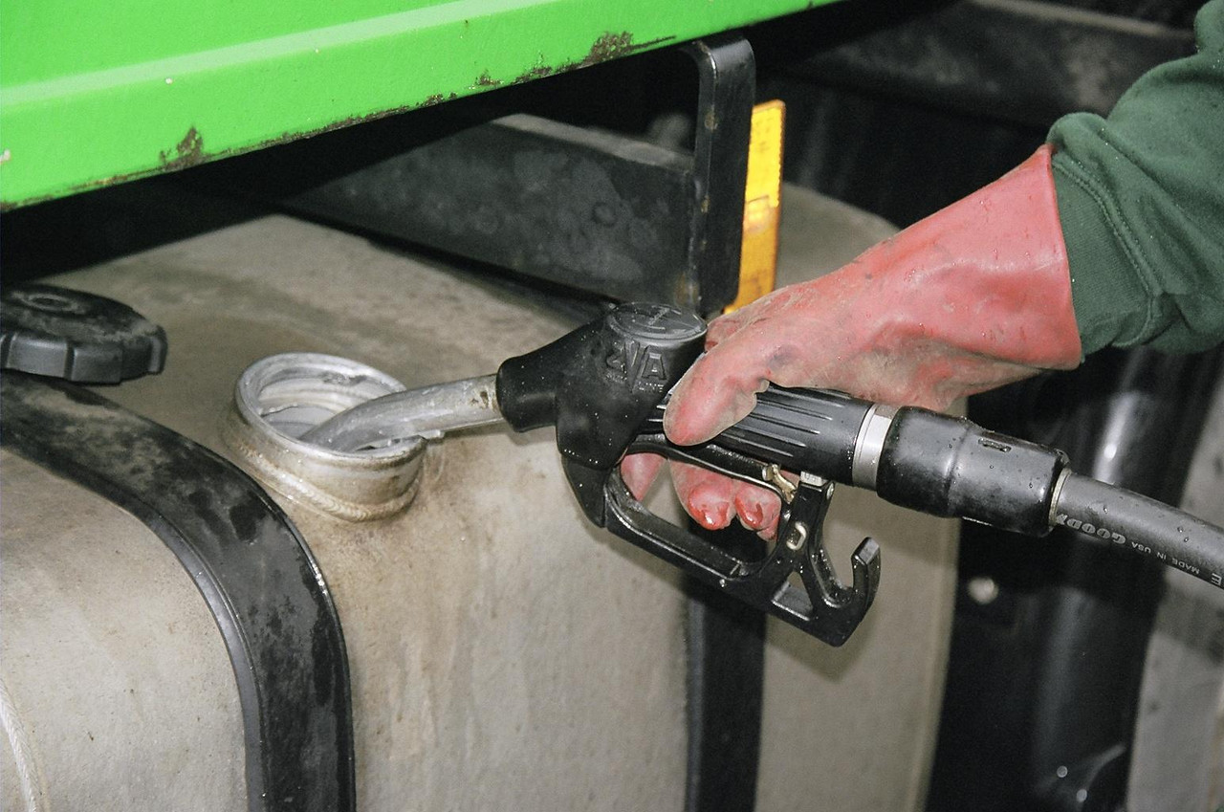
Understanding the toolbox talk
How long do points stay on the driving record for?
Why is it important to check tread depths regularly and what is the minimum tread depth that truck tyres must have?
Why do you need to think about fuel and tyre usage?
What are the benefits of adopting best practice in fuel efficient driving and improved tyre usage?
How long should your vehicle be stationary before you switch off the engine?
Notes:
Why do you need to think about fuel and tyre usage?
What are the benefits of adopting best practice in fuel efficient driving and improved tyre usage?
Why is it important to record your fuel and tyre usage for every journey?
How long should your vehicle be stationary before you switch off the engine?
What are some of the common causes of tyre damage?
What level of fine and how many points does a bald or defective tyre carry?
How long do points stay on the driving record for?
Why is it important to check tread depths regularly and what is the minimum tread depth that truck tyres must have?
Why is it important to plan your journey before you set out?

Slide 11
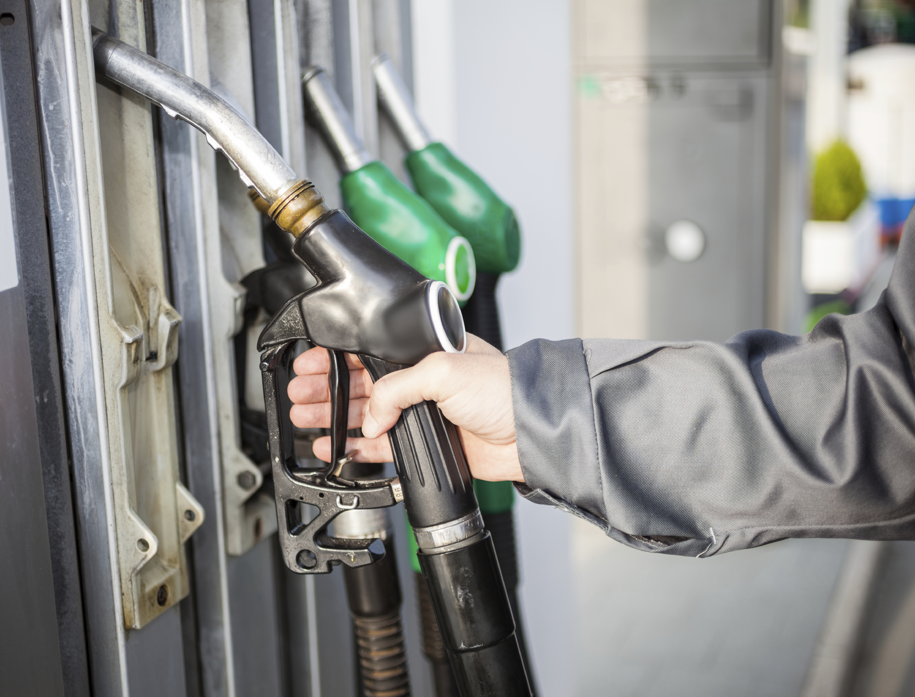
Fuel and tyre usage summary
To sum up, we need to make sure fuel and tyre usage is minimised and recorded after every journey. This can help to:
Reduce fuel spend
Improve road safety
Increase productivity and vehicle utilisation
Reduce vehicle operating costs
Reduce the likelihood of receiving fines and penalty points
Improve your job security
Notes:
To sum up, we need to make sure that fuel and tyre usage is minimised and recorded after every journey as this will help to pinpoint areas for improvement.
It is important to understand that this can help to reduce fuel spend, improve road safety, increase productivity and vehicle utilisation, reduce vehicle operating costs and reduce the likelihood of receiving fines and penalty points for driving unroadworthy vehicles.
You should also appreciate that minimising fuel and tyre usage can improve your job security and prevent you from having to pay large fines for driving unroadworthy vehicles.
Finally safer vehicles can help protect the people you love who might be killed or harmed by an unsafe vehicle.

Slide 12
Any questions ?
Notes:
Ask drivers if they have any questions. If you have difficulty with any questions, seek further advice from your manager.
Encourage discussion at the end of the presentation so drivers can interact with one another.
Follow up any points that are raised at the presentation, eg by holding a further, perhaps more specific session on issues in relation to working at height and the prevention of fall from vehicles which may have been raised in the presentation
Issue out a toolbox talk register and remind drivers to complete this, as their attendance record will be important.
Thank them for their time and ask for feedback.

