Slide 1
V6 Safe loading
Notes:
Introduce yourself and the talk
Let the audience know that the talk will take approximately twenty minutes
Before you start
Make sure you have a copy of:
The FORS standards refer to (O3 – Page 37)
Accompanying notes of the presentation
Slide packs to hand to drivers at the end of the talk

Slide 2
Fleet Operator Recognition Scheme (FORS)
FORS is important to our company because it helps us:
Demonstrate the quality of our operation
Improve our road safety record
To win / maintain work
Remain legally compliant
Become more efficient
Reduce our environmental impacts
Requirement:
Fleet operators shall ensure that vehicles are safely loaded and that appropriate load restraints are used.
Notes:
- Explain what FORS is: ‘FORS aims to raise the level of quality within fleet operations, and demonstrate which operators are achieving the standard’
You should explain to driver what you want to achieve by giving this talk
Explain the importance of FORS to the company and to the drivers
Not all the images or examples used in the talk may be relevant to how you work. Where this is the case, use examples from your own workforce.

Slide 3
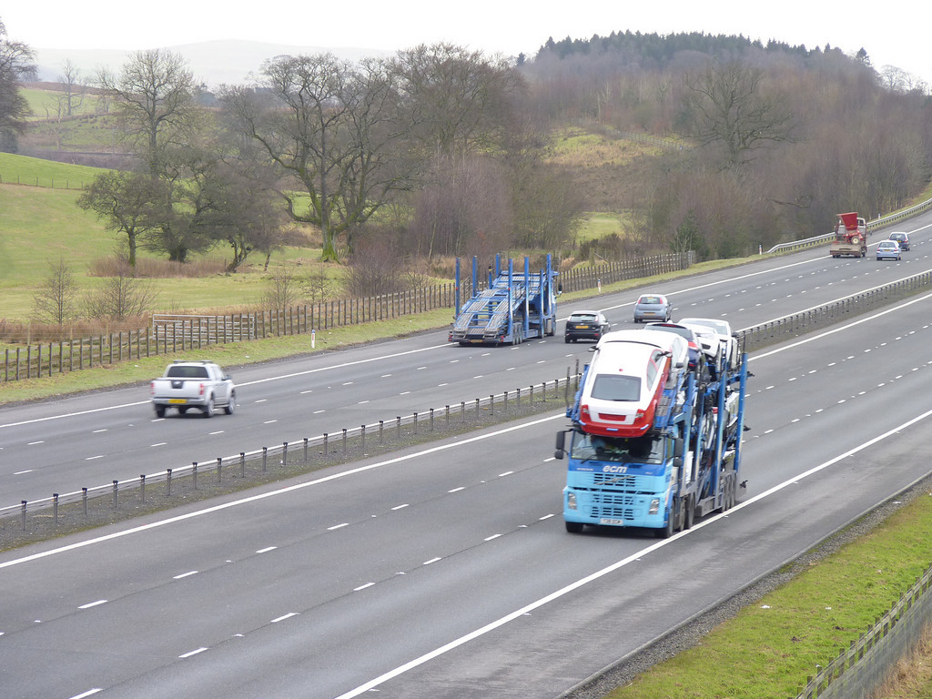
Aim of toolbox talk
Communicate this companies safe loading/unloading policy to all drivers (including sub-contracted and agency), and loading staff of ensuring that vehicles are safely loaded, loads in normal and emergency situations do not cause a hazard and that appropriate load restraints are used.
Notes:
Thinkstock image: 508327408
The aim of this toolbox talk is to communicate this companies safe loading/unloading policy to all drivers (including sub-contracted and agency), and loading staff of ensuring that vehicles are safely loaded, loads in normal and emergency situations do not cause a hazard and that appropriate load restraints are used.

Slide 4
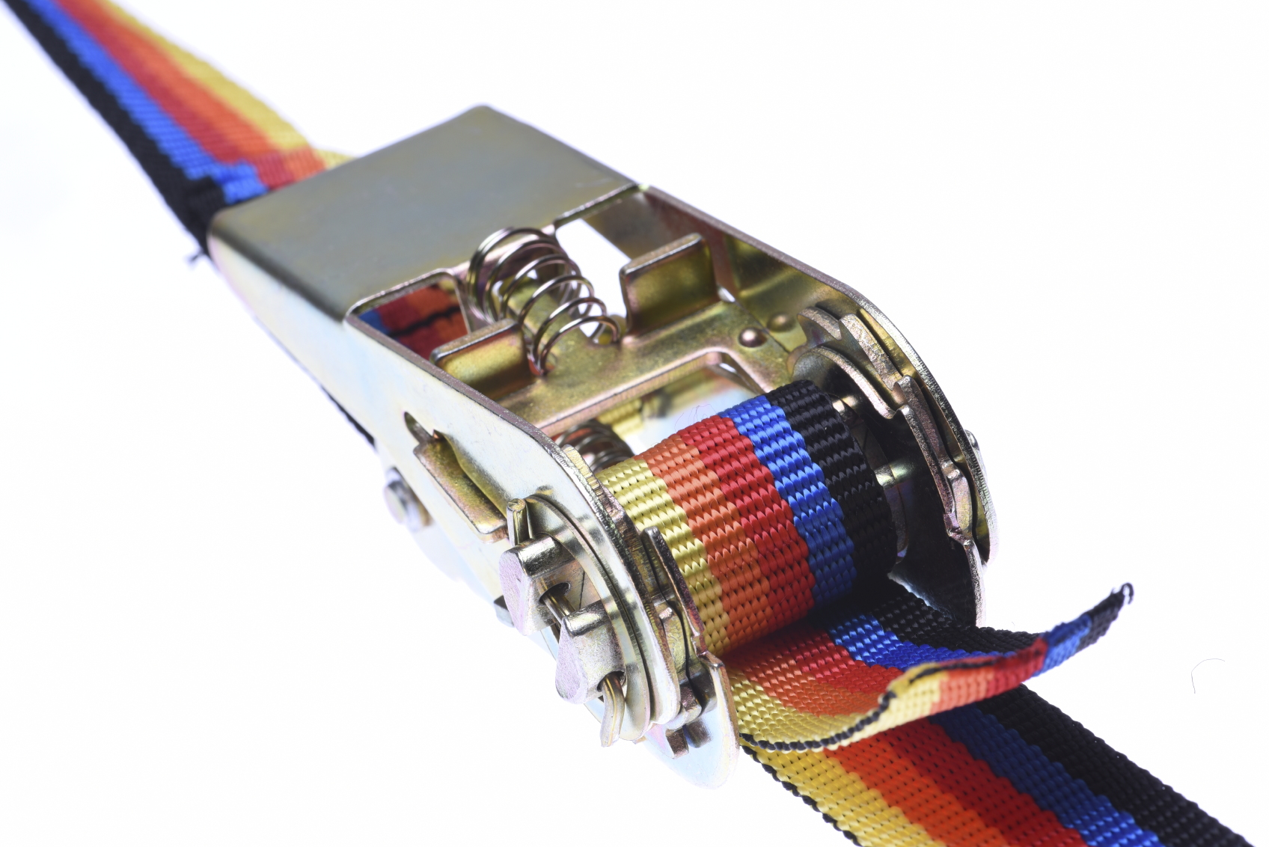
How this toolbox talk will help you
This toolbox talk covers how to load a vehicle safely, who’s responsibility this is and when load safety checks should be carried out. It also highlights what a risk assessment is what it should include.
Our company goal is to minimise the risk of incidents or injury to the public.
Notes:
Thinkstock image: 504865660
This toolbox talk covers how to load a vehicle safely, who’s responsibility this is and when load safety checks should be carried out. It also highlights what a risk assessment is what it should include
Our company goal is to minimise the risk of incidents or injury to the public. The talk will end with some confirmatory questions, so listen up!

Slide 5
Why safe loading?
You are bound by law to pay attention to the weight, size and security of any load carried on your vehicle.
Notes:
During 2013/14, DVSA issued over 2,000 prohibitions to vehicles which presented a road safety risk because of how their load was secured.
In the same period, Highways England reported over 22,000 road impact incidents caused by objects falling from vehicles. This is dangerous to all road users
You are bound by law to pay attention to the weight, size and security of any load carried on your vehicle. The law requires a load to be arranged and secured so that there is no likelihood of danger, injury or nuisance to any person.

Slide 6
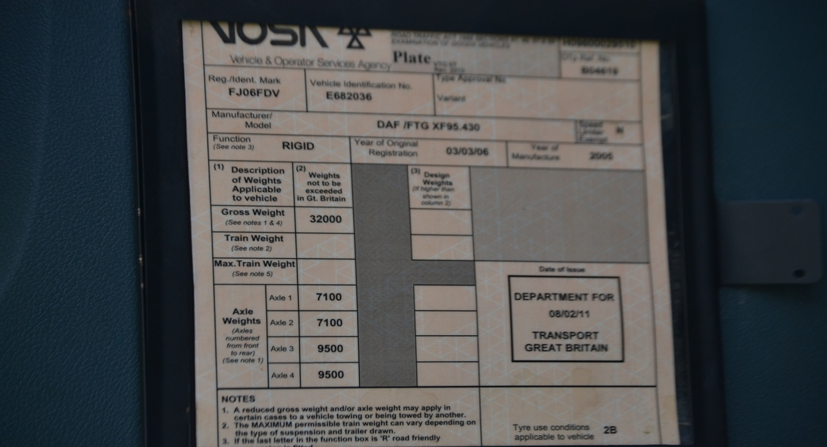
Penalties for safe loading
5% to 10% - £100
10% to 15% - £200
15% to 30% - £300
More than 30% - Prosecution

Slide 7
Who needs to make sure vehicles are loaded safely?
YOU are required to know how to load a vehicle safely
YOU must make sure that the right type of vehicle is used for the load
YOU should make sure that the vehicle is loaded so the load remains in a safe condition during loading, transit and unloading.
If you did not witness the vehicle being loaded then you should check that the load is in a safe condition before you continue your journey.
Notes:
Thinkstock image: 453518925
Both you (including sub-contracted and agency) and all loading staff are required to know how to load a vehicle safely.
You and anyone responsible for loading a vehicle must make sure that the right type of vehicle is used for the load and that the load is distributed evenly and secured correctly.
If you’re responsible for loading vehicles, you should make sure that they’re loaded so the load remains in a safe condition during loading, transit and unloading.
Emphasise on this point: If you are the driver but did not witness the vehicle being loaded / unloaded then you should check that the load is in a safe condition before you commence / continue your journey.

Slide 8
What is a risk assessment
A risk assessment is a systematic process of evaluating the potential risks that may be involved in a projected activity or undertaking. The risk assessment should cover the following:
Are loading/unloading operations carried out in an area away from passing traffic, pedestrians and others not involved in the loading/unloading operation?
Are the load(s), the delivery vehicle(s) and the handling vehicle(s) compatible with each other?
Are loading/unloading activities carried out on ground that is flat, firm and free from potholes?
Are the vehicles braked and/or stabilised, as appropriate, to prevent unsafe movements during loading and unloading operations?
Is appropriate lifting equipment available for (un)loading vehicles?
Notes:
Select the questions which are relevant to your work place
A risk assessment is a systematic process of evaluating the potential risks that may be involved in a projected activity or undertaking.
The risk assessment should cover the following:
Are loading/unloading operations carried out in an area away from passing traffic, pedestrians and others not involved in the loading/unloading operation?
Are the load(s), the delivery vehicle(s) and the handling vehicle(s) compatible with each other?
Are loading/unloading activities carried out on ground that is flat, firm and free from potholes?
Are parking brakes always used on trailers and tractive units to prevent unwanted movement, e.g. when coupling vehicles?
Are the vehicles braked and/or stabilised, as appropriate, to prevent unsafe movements during loading and unloading operations?
Are systems in place to prevent trucks driving away while they are still being (un)loaded?
Are lorry drivers and others kept in a safe place away from the vehicle while (un)loading is carried out (if necessary)?
Is there a safe area marked where drivers can observe loading (if necessary)?
Has the need for people to go on to the load area of the vehicle been eliminated where possible and if not is safe access provided and used?
Is appropriate lifting equipment available for (un)loading vehicles?
Is loading/unloading carried out so that, as far as possible, the load is spread evenly to avoid the vehicle or trailer becoming unstable?
Are checks made to ensure the load is adequately secured in line with the Department for Transport Code of Practice and not loaded beyond their capacity before the vehicle leaves the site?

Slide 9
Points to emphasise
During an average year there are around 4,000 successful prosecutions for unsafe loads.
An unsafe loading/unloading offence carries 3 penalty points and a licence endorsement for you.
You should be fully trained on the correct methods of loading and unloading a vehicle safely including correct use of restraints and aids.
The Driver & Vehicle Standards Agency (DVSA) and the police have powers to issue fines (graduated fixed penalty scheme) to any driver in charge of a vehicle that is overloaded or if the load is insecure.

Slide 10
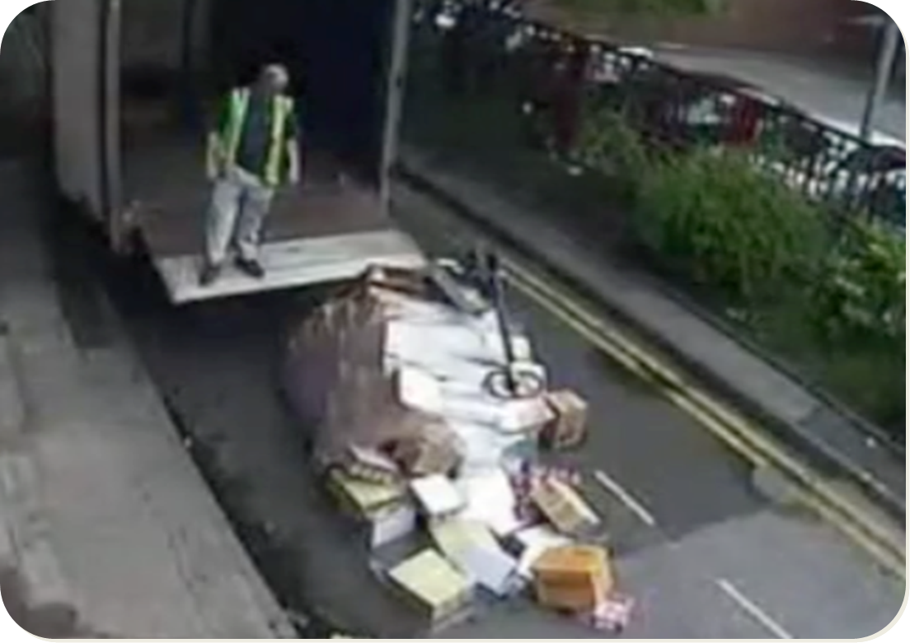
Dynamic risk assessment

Slide 11
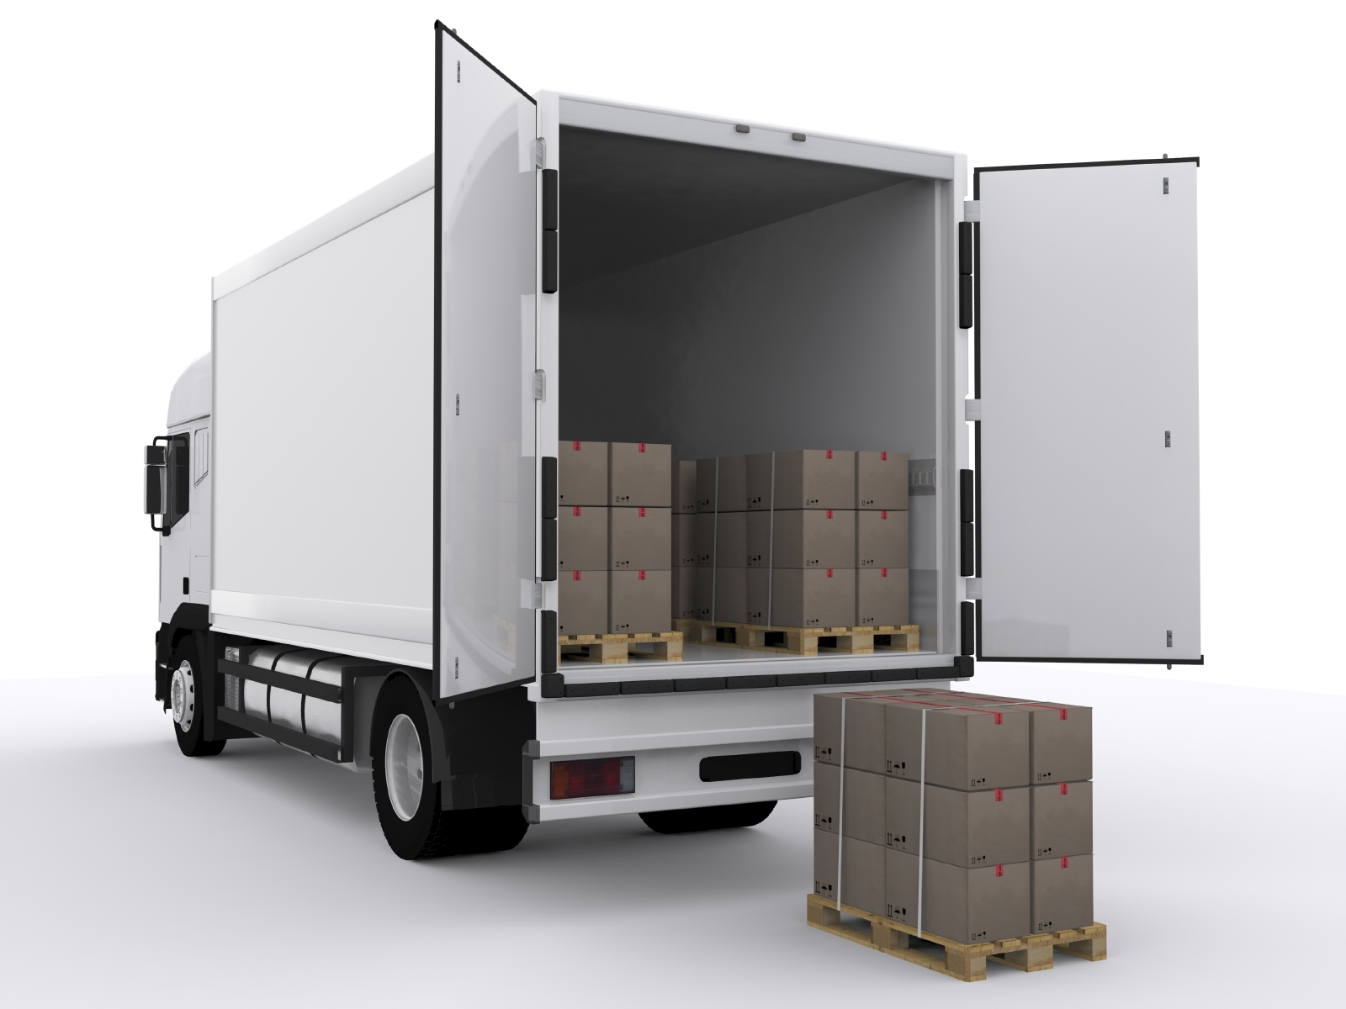
How to load your vehicle safely
Use adequate load restraints
Spread the load as evenly as possible, during both loading and unloading.
Loads should be secured, or arranged so that they do not slide around
Make sure safety equipment is considered
Loads must be suitably packaged
Use weighbridges to ensure your vehicle is not overloaded
Notes:
Thinkstock image: 164923442
Use adequate load restraints
Spread the load as evenly as possible, during both loading and unloading. Uneven loads can make the vehicle or trailer unstable
Loads should be secured, or arranged so that they do not slide around. Racking may help stability
Make sure safety equipment is considered. Mechanical equipment and heavy moving loads are dangerous
Guards or skirting plates may be necessary if there is a risk of anything being caught in machinery (for example dock levellers or vehicle tail lifts). There may be other mechanical dangers and safety procedures to be considered
Ensure the vehicle or trailer has its brakes applied and all stabilisers are used. The vehicle should be as stable as possible
Never overload the vehicle. Overloaded vehicles can become unstable, difficult to steer or be less able to brake
Always check the floor or deck of the loading area before loading to make sure it is safe. Look out for debris, broken boarding, etc
Loading should allow for safe unloading
Loads must be suitably packaged. When pallets are used, you need to check that:
They are in good condition
Loads are properly secured to them.
Loads are safe on the vehicle. They may need to be securely attached to make sure they cannot fall off.
Use weighbridges to ensure your vehicle is not overloaded. (If this is being delivered in a company the locations of nearest weighbridges should be identified and given

Slide 12
Example loading plan
Notes:
This slide demonstrates an example loading plan.
If relevant to your workplace, please keep this slide and explain the benefits of using loading plans.
If you have examples to use from your workplace, please replace the slide.
Alternatively you can remove this slide if it is not relevant to your workplace.

Slide 13
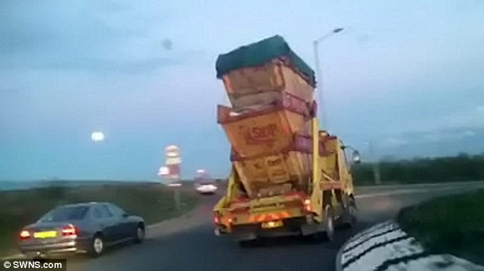
Safe loading?

Slide 14
Top tips!
FACT! Know your vehicle and its load, don’t guess
Understand the load you are carrying and what you need to do to complete your journey safely and efficiently
Ensure your vehicle is not overloaded, either by gross weight or in terms of individual axle loads. You can find out the weight at your company’s weighbridge or a public one.

Slide 15
Benefits
If you load your vehicles safely it can:
Prevent goods from falling onto roads while on the journey.
Prevent goods getting damaged before they reach their destinations thus saving time and money
Reduce likelihood of accidents occurring
Reduce the likelihood of fines
Notes:
Thinkstock image: 531213903

Slide 16
Understanding the toolbox talk
Who should you report to on arrival?
Is appropriate lifting equipment available for (un)loading vehicles? And who will load/unload the vehicle and what equipment will be required.
Are the load(s), the delivery vehicle(s) and the handling vehicle(s) compatible with each other?
Are parking brakes always used on trailers and tractive units to prevent unwanted movement, eg when coupling vehicles?
What should you do if the load shifts during the journey?
Notes:
1. Who should you report to on arrival?
2. Is appropriate lifting equipment available for (un)loading vehicles? And who will load/unload the vehicle and what equipment will be required.
3. Are the load(s), the delivery vehicle(s) and the handling vehicle(s) compatible with each other?
4. Are parking brakes always used on trailers and tractive units to prevent unwanted movement, eg when coupling vehicles?
6. What things should you be looking for when loading/unloading your vehicle?
7. What should you do if the load shifts during the journey?

Slide 17
Safe loading summary
To sum up, we need to make sure vehicles are loaded safely, loads in normal and emergency situations do not cause a hazard and that appropriate load restraints are used.
The law requires a load to be arranged and secured so that there is no likelihood of danger, injury or nuisance to any person.
Penalties for overloading can result in prosecution.
Risk assessments are again required by law and are an essential part of identifying sensible measures to control the risks in your workplace.
Remember if we get a bad reputation with VOSA, the authorities will make sure that our vehicles are checked more regularly
Notes:
To sum up, we need to make sure vehicles are loaded safely, loads in normal and emergency situations do not cause a hazard and that appropriate load restraints are used. This is done to prevent goods from falling onto roads while on the journey, prevent goods getting damaged in transit and reduce the likelihood of accidents and fines.
The law requires a load to be arranged and secured so that there is no likelihood of danger, injury or nuisance to any person. Penalties for overloading can result in prosecution. It is your responsibility as a driver to ensure your vehicle is loaded safely whether you loaded it or not.
Risk assessments are again required by law and are an essential part of identifying sensible measures to control the risks in your workplace. They help you decide whether you have covered all you need to.
Thank you for your time – and now I would like your feedback.

Slide 18
Any questions ?
Notes:
Ask drivers if they have any questions. If you have difficulty with any questions, seek further advice from your manager.
Encourage discussion at the end of the presentation so drivers can interact with one another.
Follow up any points that are raised at the presentation, eg by holding a further, perhaps more specific session on issues in relation to working at height and the prevention of fall from vehicles which may have been raised in the presentation
Issue out a toolbox talk register and remind drivers to complete this, as their attendance record will be important.
Thank them for their time and ask for feedback.

