Slide 1
V2 Daily walkaround check
Notes:
Introduce yourself and the talk
Let the audience know that the talk will take approximately twenty minutes
Before you start
Make sure you have a copy of:
The FORS standards refer to (O3 – Page 37)
Accompanying notes of the presentation
Slide packs to hand to drivers at the end of the talk

Slide 2
Fleet Operator Recognition Scheme (FORS)
FORS is important to our company because it helps us:
Demonstrate the quality of our operation
Improve our road safety record
To win / maintain work
Remain legally compliant
Become more efficient
Reduce our environmental impacts
Requirement:
Fleet operators shall ensure that vehicles are checked before each shift.
Notes:
- Explain what FORS is: ‘FORS aims to raise the level of quality within fleet operations, and demonstrate which operators are achieving the standard’
You should explain to driver what you want to achieve by giving this talk
Explain the importance of FORS to the company and to the drivers
Not all the images or examples used in the talk may be relevant to how you work. Where this is the case, use examples from your own workforce.

Slide 3
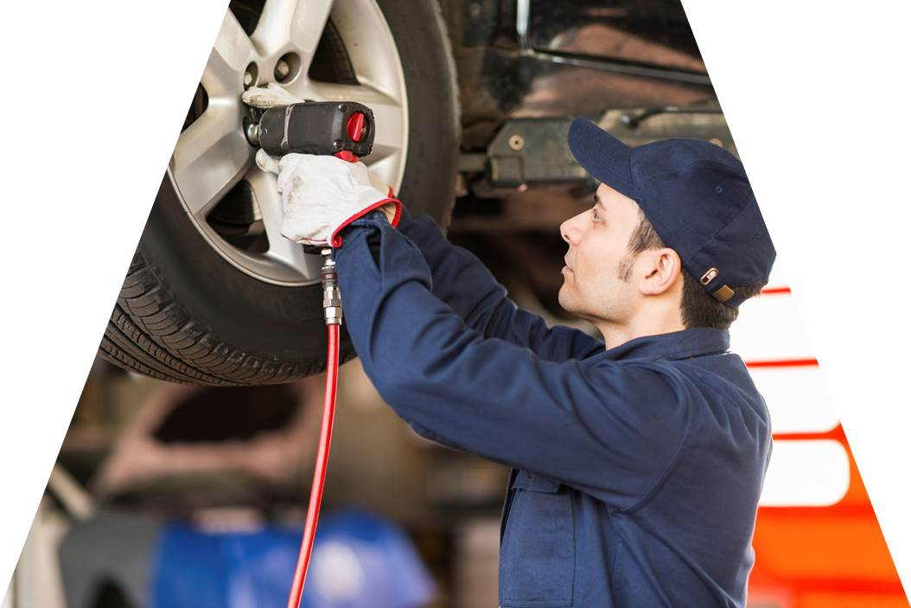
Aim of toolbox talk
The aim of this toolbox talk is to ensure that vehicles are inspected for safety by competent drivers and defects rectified by competent persons prior to usage on each shift to ensure the safety of operations.
Notes:
Thinkstock image: 86534141
This slide introduces the tool box talk and what we aim to achieve by presenting this talk.
The aim of this toolbox talk is to communicate company policy of ensuring all drivers (including sub-contracted and agency drivers) conduct a daily walkaround check of their vehicle before each shift to ensure it is safe and in full working order.
The talk should also be used to inform drivers that all staff and vehicles will be properly assessed before they return to the road.
Not all the images or examples used in the talk may be relevant to how you work. Where this is the case, use examples from your own workforce. There may also be some risks that apply at your workplace that aren't included in the talk. Before you use the talk, check its contents against your own risk assessment and add any information that you think is necessary

Slide 4
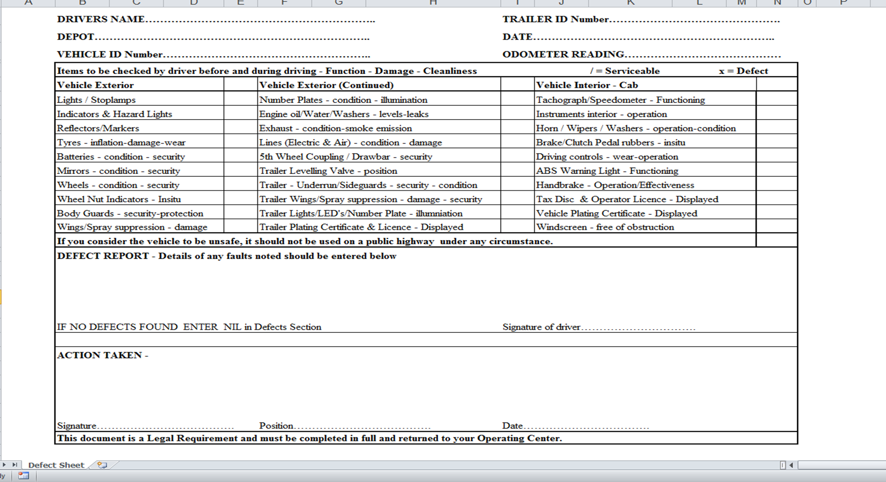
How this toolbox talk will help you
This toolbox talk covers:
What, and how check the vehicle for roadworthiness.
How to report any defects.
Our vehicles are an important asset. As such they need to be looked after
Notes:
This toolbox talk covers what and how to check the vehicle for roadworthiness and how to report any defects. Our vehicles are an important asset. As such they need to be looked after. Our company goal is to minimise any issues that will impact negatively on our business. If not properly managed and maintained we are more likely to have or cause accidents. The talk will end with some confirmatory questions, so listen up!

Slide 5
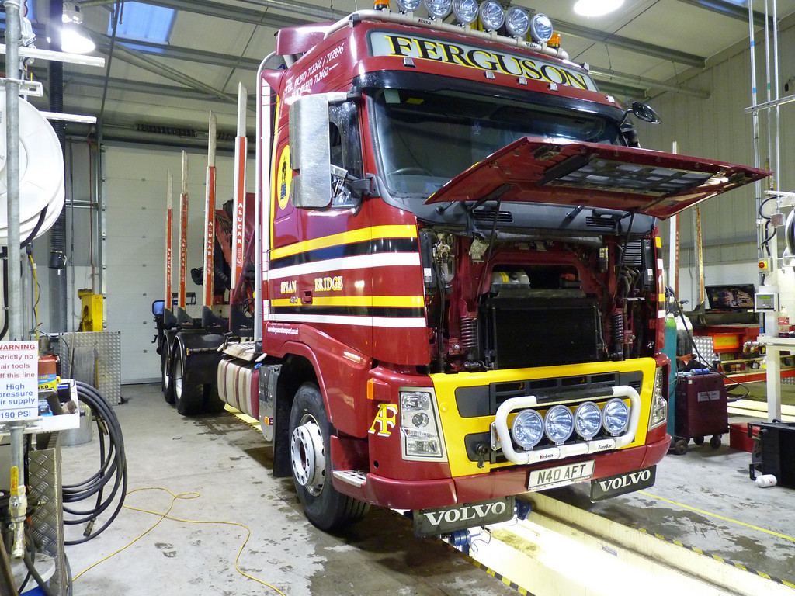
Why we carry out a daily walkaround check?
It’s estimated that 85% of roadworthiness infringements could be avoided if the driver does a walkaround check before starting the journey
A daily walk around check will help to ensure that the vehicle is:
Clean
Roadworthy
Safe to drive
Legal
It also helps to:
Highlight and fix any defects
Reduce maintenance costs / vehicle downtime
Notes:
Thinkstock image 177043382
It’s estimated that 85% of roadworthiness infringements could be avoided if the driver does a walkaround check before starting the journey
In 2014, it was reported that two thirds of lorries stopped by police were defective or being driven illegally.
A recent study by DVSA revealed that many vans fail their first time and around a quarter of prohibitions issued to vans are due to the condition of the tyres.
A daily walkaround check helps to ensure that the vehicle is:
Clean
Roadworthy
Safe to drive
This helps keep you, your vehicle and other road users safe by reducing the likelihood of incidents or collisions.
The walk around check should also help to highlight and fix any defects before they cause a more serious problem. This can reduce maintenance costs as well as vehicle downtime.
Making sure your vehicle is roadworthy and safe to drive is a legally-binding aspect of being a driver. Failure to comply can lead to a prohibition, a fixed penalty and penalty points to your licence

Slide 6
Walkaround check for lorry

Slide 7
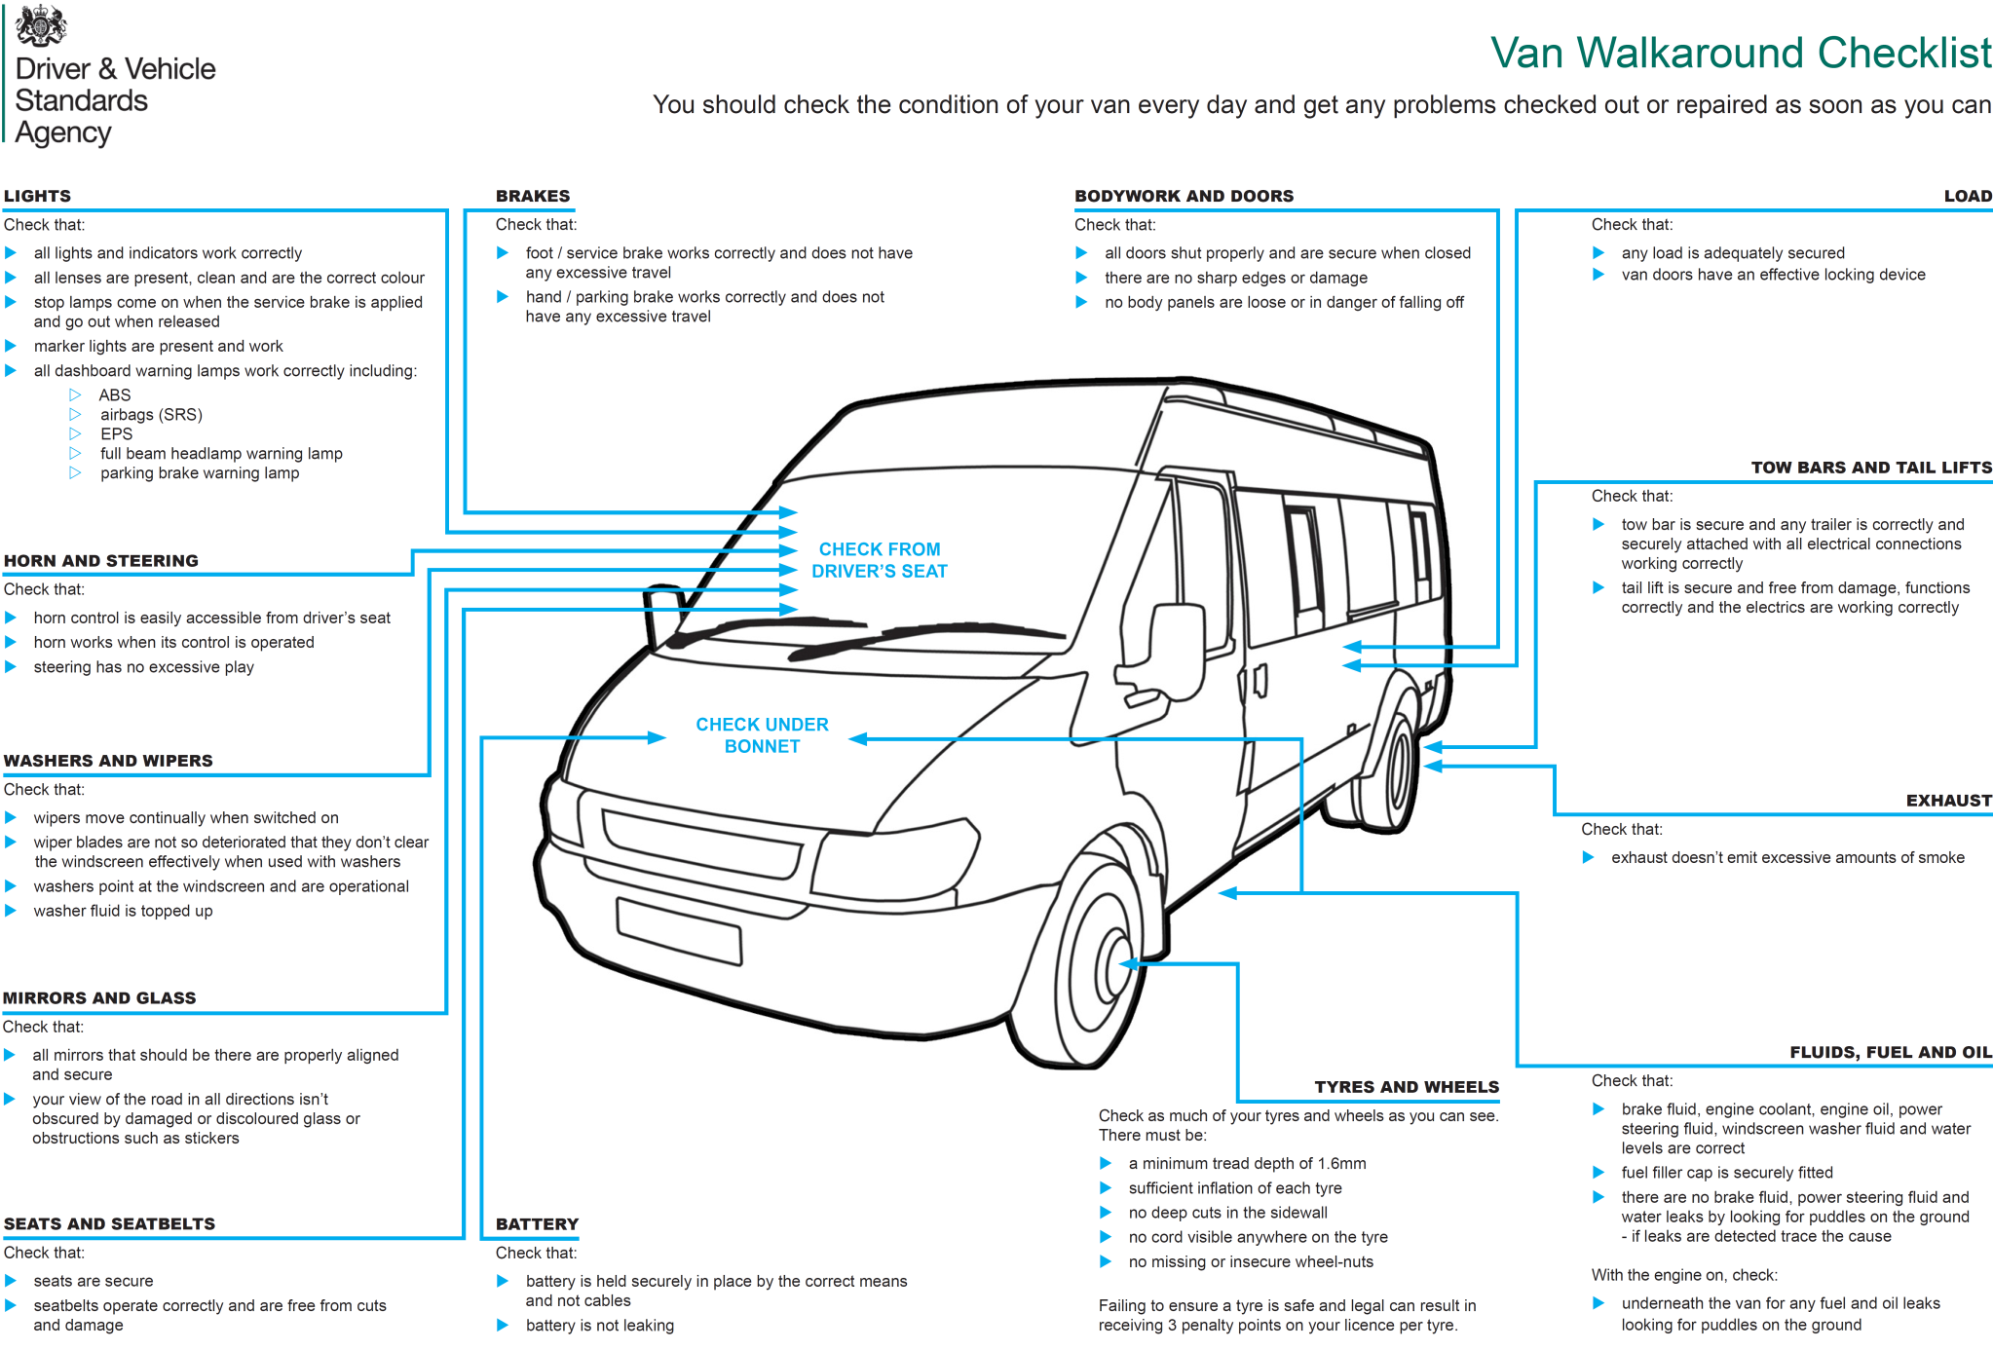
Walkaround check for van

Slide 8
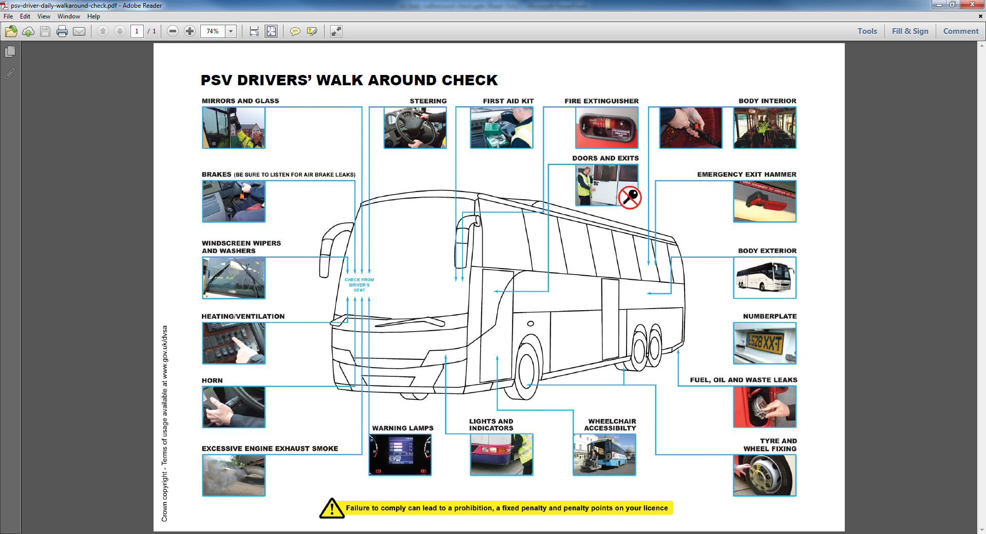
Walkaround check for PSV

Slide 9
As a driver…
It’s your responsibility to:
Maintain the roadworthiness of your vehicle. This will help avoid problems with vehicle checks.
Ensure your vehicle is safe to drive before setting off on a journey.
As part of your walkaround check you should also check that the vehicle is clean on the outside and inside.
Daily defect checks are vital, and the results of such checks shall be recorded
You may be prosecuted for the existence of defects found on the vehicle you drive if you are considered partly or wholly responsible for the existence of them
Notes:
All drivers (including sub-contracted and agency drivers) are required to check their vehicle on a daily basis. As the driver, you are responsible for the condition of your vehicle when in use on the road.
Drivers shall check the vehicle and have defects rectified (if necessary) by a competent person(s) prior to usage on each shift.
Checking a vehicle before setting out means you make sure your vehicle is roadworthy and that you will spot any defects before they cause an accident, helping to keep you and other road users safe.
As part of your walkaround check you should also check that the vehicle is clean on the outside and inside. Do not leave rubbish on the dashboard. Make sure that paperwork and delivery notes are in a ring binder or folder and not scattered around the cab.
Daily defect checks are vital, and the results of such checks shall be recorded. If you report defects then the maintenance team can fix it. Doing the walkaround checks means that defects are spotted early, before they become more serious. This means that the repair cost may be lower and the vehicle will spend less time off the road. This helps the company to become more profitable - which ultimately benefits you.
You, the driver are legally responsible for the vehicle you are driving. You may be prosecuted for the existence of defects found on the vehicle you drive if you are considered partly or wholly responsible for the existence of them. Failure to take these responsibilities seriously could result in the loss of the driver’s licence to drive.

Slide 10
Defect reporting
Use a daily walkaround checklist and vehicle defect form:
Submit this to your manager for record keeping purposes..
If you do discover a defect, you must record it and report it by submitting the walkaround check immediately. Don’t wait for the end of the week.
If the defect means that the vehicle is not roadworthy then you should not drive it.
As you carry out each check, tick it off. If there is an issue, highlight it. If you are not sure about something, ask for help.
It is important that we have a record that these checks have taken place. Completed forms are reviewed and influence decision making
Notes:
Use a daily walkaround checklist and vehicle defect form (see example below).
Submit this to your manager for record keeping purposes. Records shall be retained for 15 months, except for nil defect reports which should be kept until the next safety inspection.
If you do discover a defect, you must record it and report it by submitting the walkaround check immediately. Don’t wait for the end of the week. If the defect means that the vehicle is not roadworthy then you should not drive it. Speak to your manager or supervisor immediately to confirm that the vehicle is not roadworthy and they will arrange for a repair or an alternative vehicle for the shift. Remember to do the walkaround check on any substitute vehicle provided.
As you carry out each check, tick it off. If there is an issue, highlight it. If you are not sure about something, ask for help either from your manager, supervisor or another colleague.
It is important that we have a record that these checks have taken place. Completed forms are reviewed and influence decision making. For example, if a particular vehicle keeps on having defects reported we might consider replacing it with a newer vehicle. It may even influence the make of vehicle we buy in the future

Slide 11
Benefits
Conducting daily walk around checks can help to:
Improve vehicle performance
Reduce the likelihood of accidents
Improve reputation and corporate image
Reduce fines and penalty points
Prevent the need for costly repair
Spot dangerous issues before the vehicle is used
Notes:
If drivers undertake daily walkaround checks it results in:
Improved performance of the vehicles as defects are reported and fixed before they become a serious problem
Improved reputation and corporate image as a clean and well maintained vehicle looks professional
Reduced likelihood of accidents with their attendant cost, time and reputation loss
Reduced fines and penalty points
If vehicle defects are sufficiently serious they can result in a charge of dangerous driving. This can result in 3-11 points, 2 years imprisonment, unlimited fine and obligatory disqualification.

Slide 12
Understanding the toolbox talk
Who needs to do the vehicle checks?
When should the daily walk around checks be carried out?
What is the purpose of doing a walkaround check?
What must you do if you discover a defect?
What things should you be looking for when checking the tyres and wheels?
What should you be looking for when checking inside the cab and externally?
Notes:
1. Who needs to do the vehicle checks?
2. When should the daily walk around checks be carried out?
3. How often should a walkaround check be carried out?
4. What is the purpose of doing a walkaround check?
5. What must you do if you discover a defect?
6. What things should you be looking for when checking the tyres and wheels?
7. What should you be looking for when checking inside the cab and externally?

Slide 13
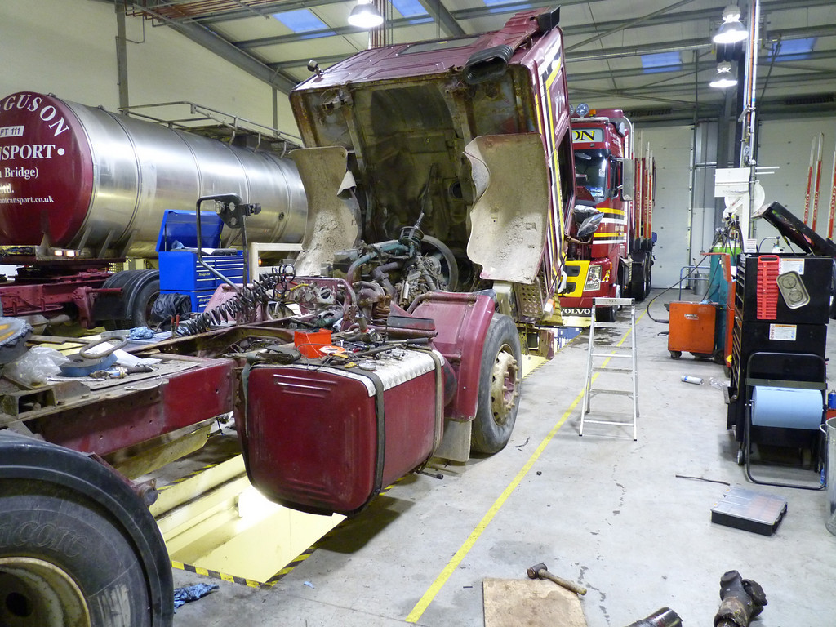
Daily walkaround check summary
To sum up, we need to make sure:
Vehicles are checked daily
Checks are recorded
Defects are rectified and reported to the relevant person
It costs a company a lot more to deal with breakdowns and servicing neglected vehicles than having thorough daily checks and routine servicing.
Notes:
Think stock image: 91604001
To sum up, we need to make sure our vehicles are roadworthy and safe to drive. You should now understand why walkaround checks are so important, how to do them, what to look out for, and when and how to submit the forms if there is nothing to report and how to report a defect. The key priorities are to keep you and other road users safe. Remember to always submit your completed walkaround check sheets, even if no defects have been found as we need them for our records.
Thank you for your time – and now I would like your feedback.

Slide 14
Any questions ?
Notes:
Ask drivers if they have any questions. If you have difficulty with any questions, seek further advice from your manager.
Encourage discussion at the end of the presentation so drivers can interact with one another.
Follow up any points that are raised at the presentation, eg by holding a further, perhaps more specific session on issues in relation to working at height and the prevention of fall from vehicles which may have been raised in the presentation
Issue out a toolbox talk register and remind drivers to complete this, as their attendance record will be important.
Thank them for their time and ask for feedback.

