Slide 1
V7 Vulnerable road user safety
Notes:
Introduce yourself and the talk
Let the audience know that the talk will take approximately twenty minutes
Before you start
Make sure you have a copy of:
The FORS standards refer to (O3 – Page 37)
Accompanying notes of the presentation
Slide packs to hand to drivers at the end of the talk

Slide 2
Fleet Operator Recognition Scheme (FORS)
FORS is important to our company because it helps us:
Demonstrate the quality of our operation
Improve our road safety record
To win / maintain work
Remain legally compliant
Become more efficient
Reduce our environmental impacts
Requirement:
Fleet operators shall ensure that all vehicles over 3.5 tonnes gross vehicle weight are fitted with safety equipment to help protect vulnerable road users.
Notes:
- Explain what FORS is: ‘FORS aims to raise the level of quality within fleet operations, and demonstrate which operators are achieving the standard’
You should explain to driver what you want to achieve by giving this talk
Explain the importance of FORS to the company and to the drivers
Not all the images or examples used in the talk may be relevant to how you work. Where this is the case, use examples from your own workforce.

Slide 3
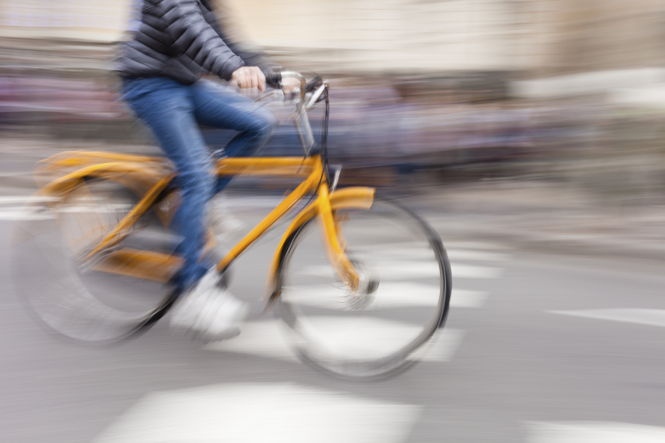
Aim of toolbox talk
Communicate the importance of considering other road users, especially vulnerable road users (e.g. pedestrians, cyclists, motorcyclists, horse riders), and outline the techniques and equipment you should use to help protect them.
Notes:
The aim of this toolbox talk is to communicate the importance of considering other road users, especially vulnerable road users (e.g. pedestrians, cyclists, motorcyclists, horse riders), and outline the techniques and equipment you should use to help protect them.
Your company needs to know that you:
Understand what is meant by the term ‘vulnerable road user’
Include all safety equipment as part of your daily walk around check
Are able to adjust your mirrors correctly
Recognise that the use of indirect vision systems is an integral part of your job

Slide 4
How this toolbox talk will help you?
This toolbox talk will mention several techniques and approaches which should help you become a safer driver and protect other road users.
Motorcyclists and cyclists not always visible when coming out of junctions, overtaking you or filtering through traffic
Horses may behave unpredictably
Children are small, playful, curious, poor at judging speed, and can run fast
Teenagers get distracted, use headphones and may challenge each other to ‘dares’
Older or disabled pedestrians walk slowly
Blind or deaf pedestrians can’t see or hear you
Notes:
This toolbox talk will mention several techniques and approaches which should help you become a safer driver and protect other road users.
The most Vulnerable Road Users are:
Pedestrians (particularly children, the elderly or the disabled
Cyclists
Motorcyclists
Horse riders
The talk will end with some confirmatory questions, so listen up!

Slide 5
What are the issues
The numbers of cyclists and pedestrians across the nation’s cities has risen considerably in recent years
Vans are involved in 10% of road traffic incidents. 11% of these incidents result in serious injury or fatality
HGV’s were involved in a quarter of deaths between 2009 & 2013
23% of HGVs involved in accidents with a pedal cyclist were said to be ‘passing too close’
It is far harder for an HGV to see a cyclist when manoeuvring in comparison with other vehicles such as cars
75% of collisions involving a cyclist happen at a junction. The most common reason being drivers ‘failing to look properly.
Notes:
The numbers of cyclists and pedestrians across the nation’s cities has risen considerably in recent years. This is because many more people now work in city centres and services are more centralised.
Every tenth vehicle on the road is a Light Commercial Vehicle (LCV). Vans are involved in 10 per cent of road traffic incidents and 11 per cent of these incidents result in serious injury or fatality.
Between 2009 and 2013 HGV’s were involved in around a quarter of deaths despite comprising only 5 per cent of traffic in GB.
Between 2009 and 2013, 23 per cent of HGVs involved in accidents with a pedal cyclist were allocated the contributory factor ‘passing too close to pedal cyclist’.
Between 2009 and 2013, 12 per cent of HGVs involved in accidents with pedal cyclists were allocated the vehicle blind spot contributory factor.
HGVs in particular are most commonly allocated the ‘vehicle blind spot’ contributory factor in accidents they are involved with pedal cyclists. It is far harder for an HGV to see a pedal cyclist when manoeuvring in comparison with other vehicles such as cars.
Our company goal is to employ safe and professional drivers ensuring they are fully versed on the correct usage of direct and indirect vision aids. By driving considering the needs of other road users, we can minimise accidents and reduce the potential of you hurting or even killing someone.
Considering other road users means:
You are less likely to be taken by surprise by the actions of other road users
Giving vulnerable road users (VRUs) the time and space they need

Slide 6
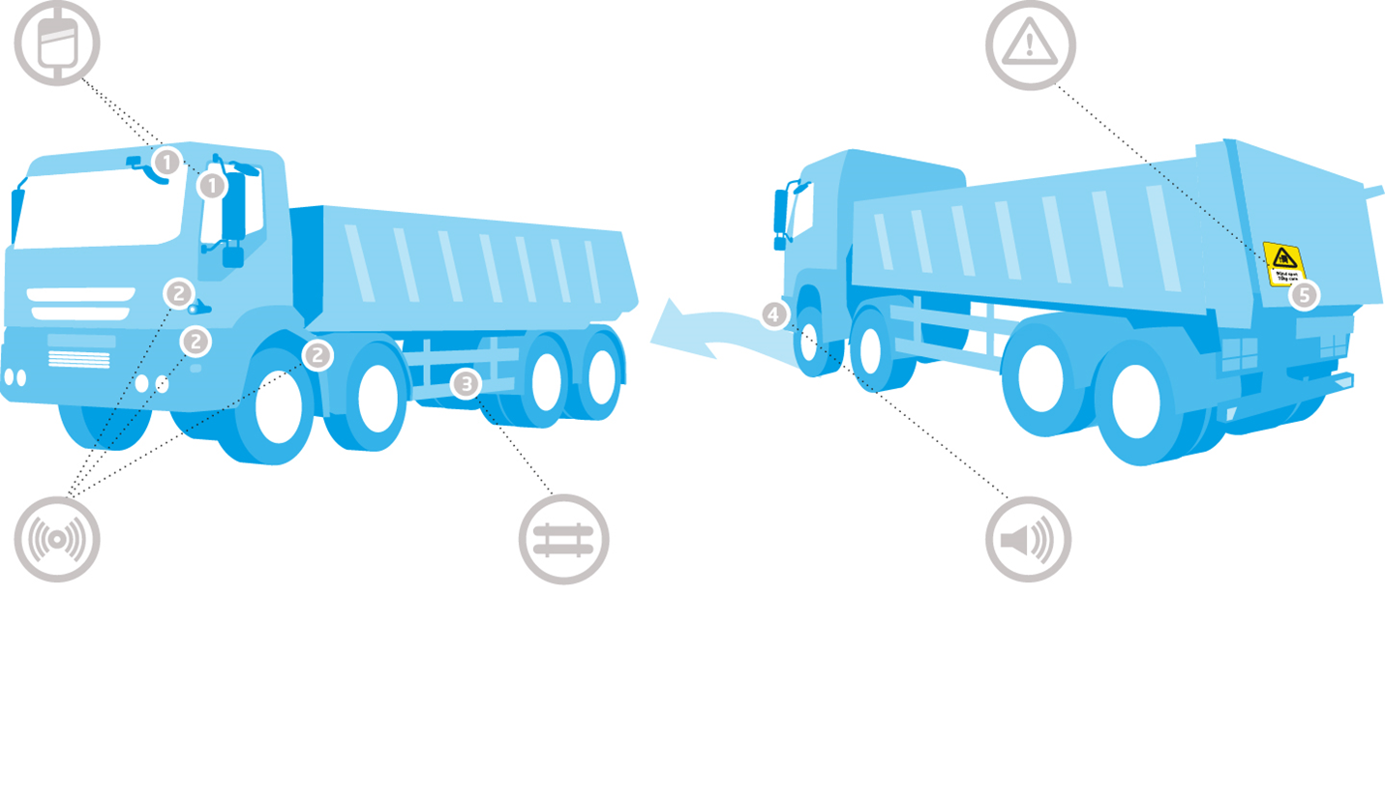
FORS requirement
1 Class V and VI mirrors
5 Vulnerable road user warning signage
3 Side under-run protection (on both sides)
4 Audible alert for vehicle turning left
2 A method of minimising the vehicle blind spots e.g camera system and/or sensor system and/or Fresnel lens (the system must be working)

Slide 7
Common collisions with cyclists
Collisions between heavy goods vehicles are cyclists often occur when:
Drivers and cyclists turning left at junctions
Cyclists and drivers fail to allow enough space for each other
Cyclists and drivers do not look properly and misjudge each other’s path or speed
Drivers overtaking too close to cyclist
Failure to judge other person’s path or speed
Poor turn or manoeuvre at junctions
Failure to look properly
Being careless/ reckless/in a hurry
Passing too close to cyclist
Notes:
Collisions between heavy goods vehicles and cyclists often occur when:
Drivers and cyclists are turning left at junctions
Cyclists and drivers fail to allow enough space for each other
Cyclists and drivers do not look properly and misjudge each other’s path or speed
Drivers overtake too closely to cyclists
The most common factors which contribute to cyclist/goods vehicle collisions, as identified by the Metropolitan Police, include:
Failure to look properly
Failure to judge other person’s path or speed
Being careless/reckless/in a hurry
Poor turn or manoeuvre
Passing too close to cyclist
ASK DRIVERS IF THEY HAVE ANY OTHERS TO ADD

Slide 8
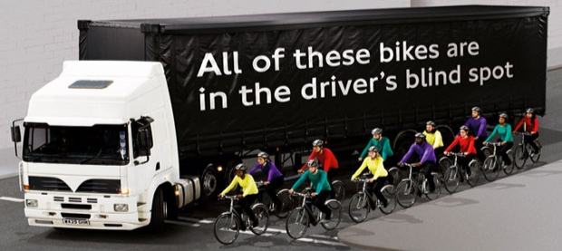
How to help protect VRU’s on the road
Before setting off on your journey:
Complete a walk-round check of your vehicle
Make sure all of your mirrors are correctly adjusted
Ensure any warning signage fitted to the vehicle is clean and clearly visible to the road user
Check any side under-run protection is fitted correctly and is serviceable
Refresh your knowledge of the Highway Code
Notes:
Highway Code
Ask the audience when they last looked at the Highway Code and what they remember from it. Remind them of the importance of refreshing their knowledge, and let them know if you have copies/training etc available to them.
If your organisation has any expectations about anything else they should be checking during their walk-round check? Make them clear here.

Slide 9
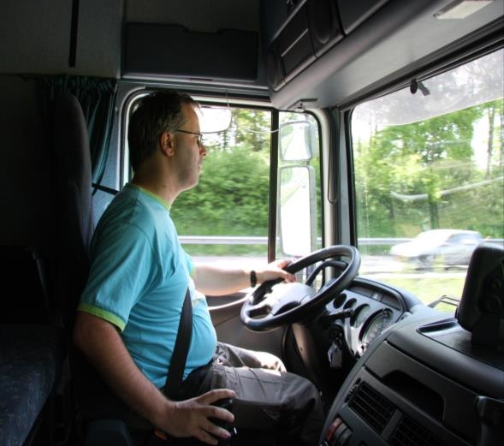
How to help protect VRU’s on the road
Whilst Driving:
Keep checking for cyclists, pedestrians and motorcyclists who may weave through stationary traffic
Look out for cyclists, especially when checking your mirrors before indicating, varying your speed or changing direction
Indicate in good time to allow others to react
Check your nearside blind spot every time you turn left
Notes:
Whilst driving:
Keep checking for cyclists, pedestrians and motorcyclists who may weave through stationary traffic
Look out for cyclists, especially when checking your mirrors before indicating, varying your speed or changing direction
75% of collisions involving a bike happen at a junction, with the most common reason being drivers ‘failing to look properly. Keep scanning your mirrors when approaching junctions in case a cyclist enters your blind spot
Before pulling away from junctions, look over the dashboard (even if you have Class V / VI mirrors fitted) and try to make eye contact with any cyclists around your vehicle so they know you’ve seen them
Indicate in good time to allow others to react
Check your nearside blind spot every time you turn left

Slide 10
How to help protect VRU’s on the road Cont..
Whilst Driving:
Give cyclists plenty of space so that they can manoeuvre to avoid potholes, drain covers or car doors
Do not cross stop lines or encroach on Advanced Stop Lines at traffic lights
Use your indicators when turning or changing lanes, even if you don’t think anyone is near you
Do not drive or park in a cycle lane marked by a solid white line while it is operational
Notes:
Use your indicators when turning or changing lanes, even if you don’t think anyone is near you (Communication is key on the road though we all know some motorists don’t indicate properly
If it doesn’t do so automatically, switch off the indicator once you’ve completed your manoeuvre to avoid giving false information to other road users)
Give cyclists plenty of space so that they can manoeuvre to avoid potholes, drain covers or car doors
When overtaking, give cyclists and motorcyclists at least as much space as you would a car
Do not cross stop lines or encroach on Advanced Stop Lines at traffic lights
Do not drive or park in a cycle lane marked by a solid white line while it is operational, or drive or park in one marked by a broken white line unless it is unavoidable

Slide 11
Benefits
Minimise the probability and severity of under-run collisions and close proximity incidents with VRUs
Make you better drivers and our operation more professional
Reduce the opportunity for unintentional breaches of company policy
Reduce the likelihood of accidents and their associated cost, time and reputation loss
Increase confidence in vehicle control and driving performance
Notes:
If we can ensure that all safety equipment is included within the daily walk around check and that all drivers recognise that the use of indirect vision systems is an integral part of their job it will help to:
Minimise the probability and severity of under-run collisions and close proximity incidents with VRUs
Make you better drivers and our operation more professional
Reduce the opportunity for unintentional breaches of company policy and the associated disciplinary implications
Reduce the likelihood of accidents and their associated cost, time and reputation loss
Increase confidence in vehicle control and driving performance

Slide 12
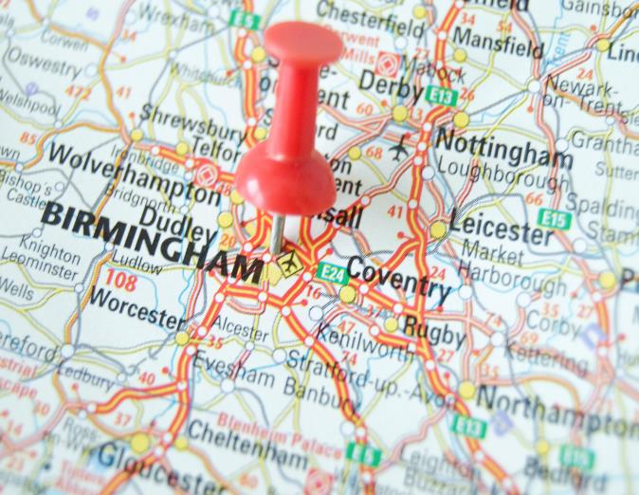
Top Tips!
Before you travel:
Plan your journey
Prepare yourself
Check your vehicle
While driving:
Look out for cyclists
Indicate clearly and in good time
Leave space

Slide 13
Understanding the toolbox talk
Who are the most vulnerable road users (VRU)?
What are some common collision causes with cyclists?
Before setting off on your journey, what can you do to help protect vulnerable road users on the road?
What measures can you take to protect vulnerable road users whilst driving?

Slide 14
Vulnerable road user safety summary
To sum up we need to make sure that:
All safety equipment is included within the daily walk around check making sure that:
warning signage is clean and visible,
mirrors are correctly adjusted ;
side under-run protection is correctly fitted and serviceable.
All drivers recognise that the use of indirect vision systems is an integral part of their job
Drivers scan their mirrors, particularly at junctions, in case a vulnerable road user has entered the blind spot
Other road users are always given plenty of room
Notes:
To sum up, we need to make sure that all safety equipment is included with the daily walk around check – making sure that warning signage is clean and visible, mirrors are correctly adjusted and side under-run protection is correctly fitted and serviceable. It is also important to recognise that the use of indirect vision systems is an integral part of your job.
When at junctions, keep scanning your mirrors in case a vulnerable road user has entered your blind spot and always give other road users plenty of room.
Thank you for your time – and now I would like your feedback.

Slide 15
Any questions ?
Notes:
Ask drivers if they have any questions. If you have difficulty with any questions, seek further advice from your manager.
Encourage discussion at the end of the presentation so drivers can interact with one another.
Follow up any points that are raised at the presentation, eg by holding a further, perhaps more specific session on issues in relation to working at height and the prevention of fall from vehicles which may have been raised in the presentation
Issue out a toolbox talk register and remind drivers to complete this, as their attendance record will be important.
Thank them for their time and ask for feedback.

